Slide 1
Mining public datasets for driving forces of immune-related adverse events (irAEs) from immune checkpoint blockade (ICB)
2-1-2024 SI meeting
Ty Bottorff – Bioinformatics postdoc
Linsley lab

Slide 2
Outline
irAE introduction
scRNAseq + scTCRseq dataset methods
Mining datasets for differences between those with/without irAEs

Slide 3
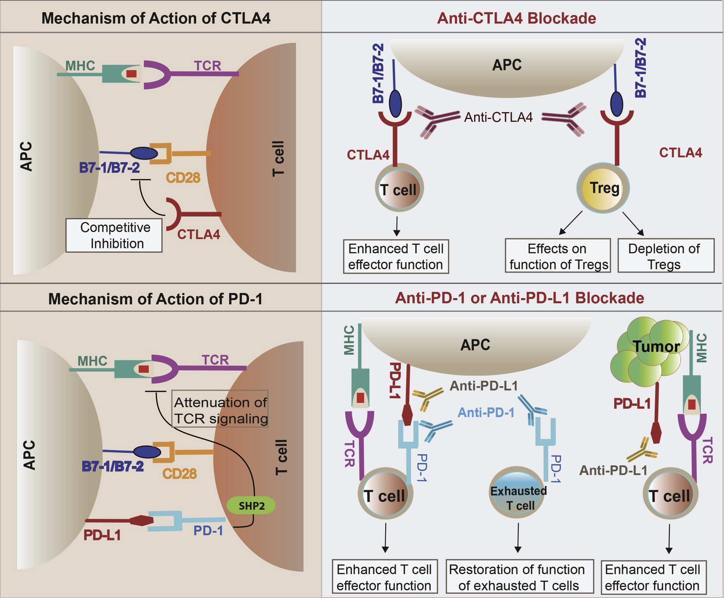
Inhibitory immune checkpoints help maintain self tolerance
Khan et al. Semin Cancer Biol. 2020
Notes:
Script:
Immune checkpoint molecules are ligand-receptor pairs that exert stimulatory or inhibitory effects on the immune response
Inhibitory checkpoints are crucial for maintaining self-tolerance and modulating the duration and magnitude of the immune response to minimize tissue damage
CTLA-4 and PD-1/PD-L1 are the most widely studied inhibitory checkpoint molecules.
CTLA-4 outcompetes CD28 (costimulatory receptor) for B7-1/2 ligands on APCs to increase threshold for T cell activation (i.e. reduces immune responses to weak antigens, self/tumor)
PD-1 expressed by activated/induced T cells; this checkpoint prevents inappropriate overactivation and limits duration of T cell activation

Slide 4
Immune checkpoint blockade (ICB) has revolutionized cancer treatment
Khan et al. Semin Cancer Biol. 2020
Notes:
Script
Immune checkpoint pathways are often activated in cancer, helping tumors evade the immune response
Immune checkpoint blockade acts to block inhibitory checkpoint molecules to enhance immune activity against tumors
Over the last decade, ICB have revolutionized cancer treatment.
CTLA-4 and PD-1/PD-L1 constitute the majority of currently FDA approved ICB drugs.
For example, PD-L1 (PD-1 ligand) expressed on tumor cells, binds PD-1 on T cells to inhibit their activation
Other notes
CTLA-4 expressed on tumor infiltrating Tregs, also activated CD4 T cells, exhausted T cells
CTLA-4 blockade likely acts in draining lymph node where CTLA-4 expressing Tregs
In 2011, ipilimumab (Yervoy) became the first ICI to receive FDA approval for metastatic melanoma. As of 2023, it remains the only CTLA-4 targeting ICI that received FDA approval
Mechanisms of immune-related adverse events during the treatment of cancer with immune checkpoint inhibitors
anti-CTLA-4 and anti-PD-1/PD-L1 antibodies called "immune enhancers" and "immune normalizers" (normalizing T cell immunity in tumor microenvironment), respectively, consistent with PD-1 blockade having less irAEs

Slide 5
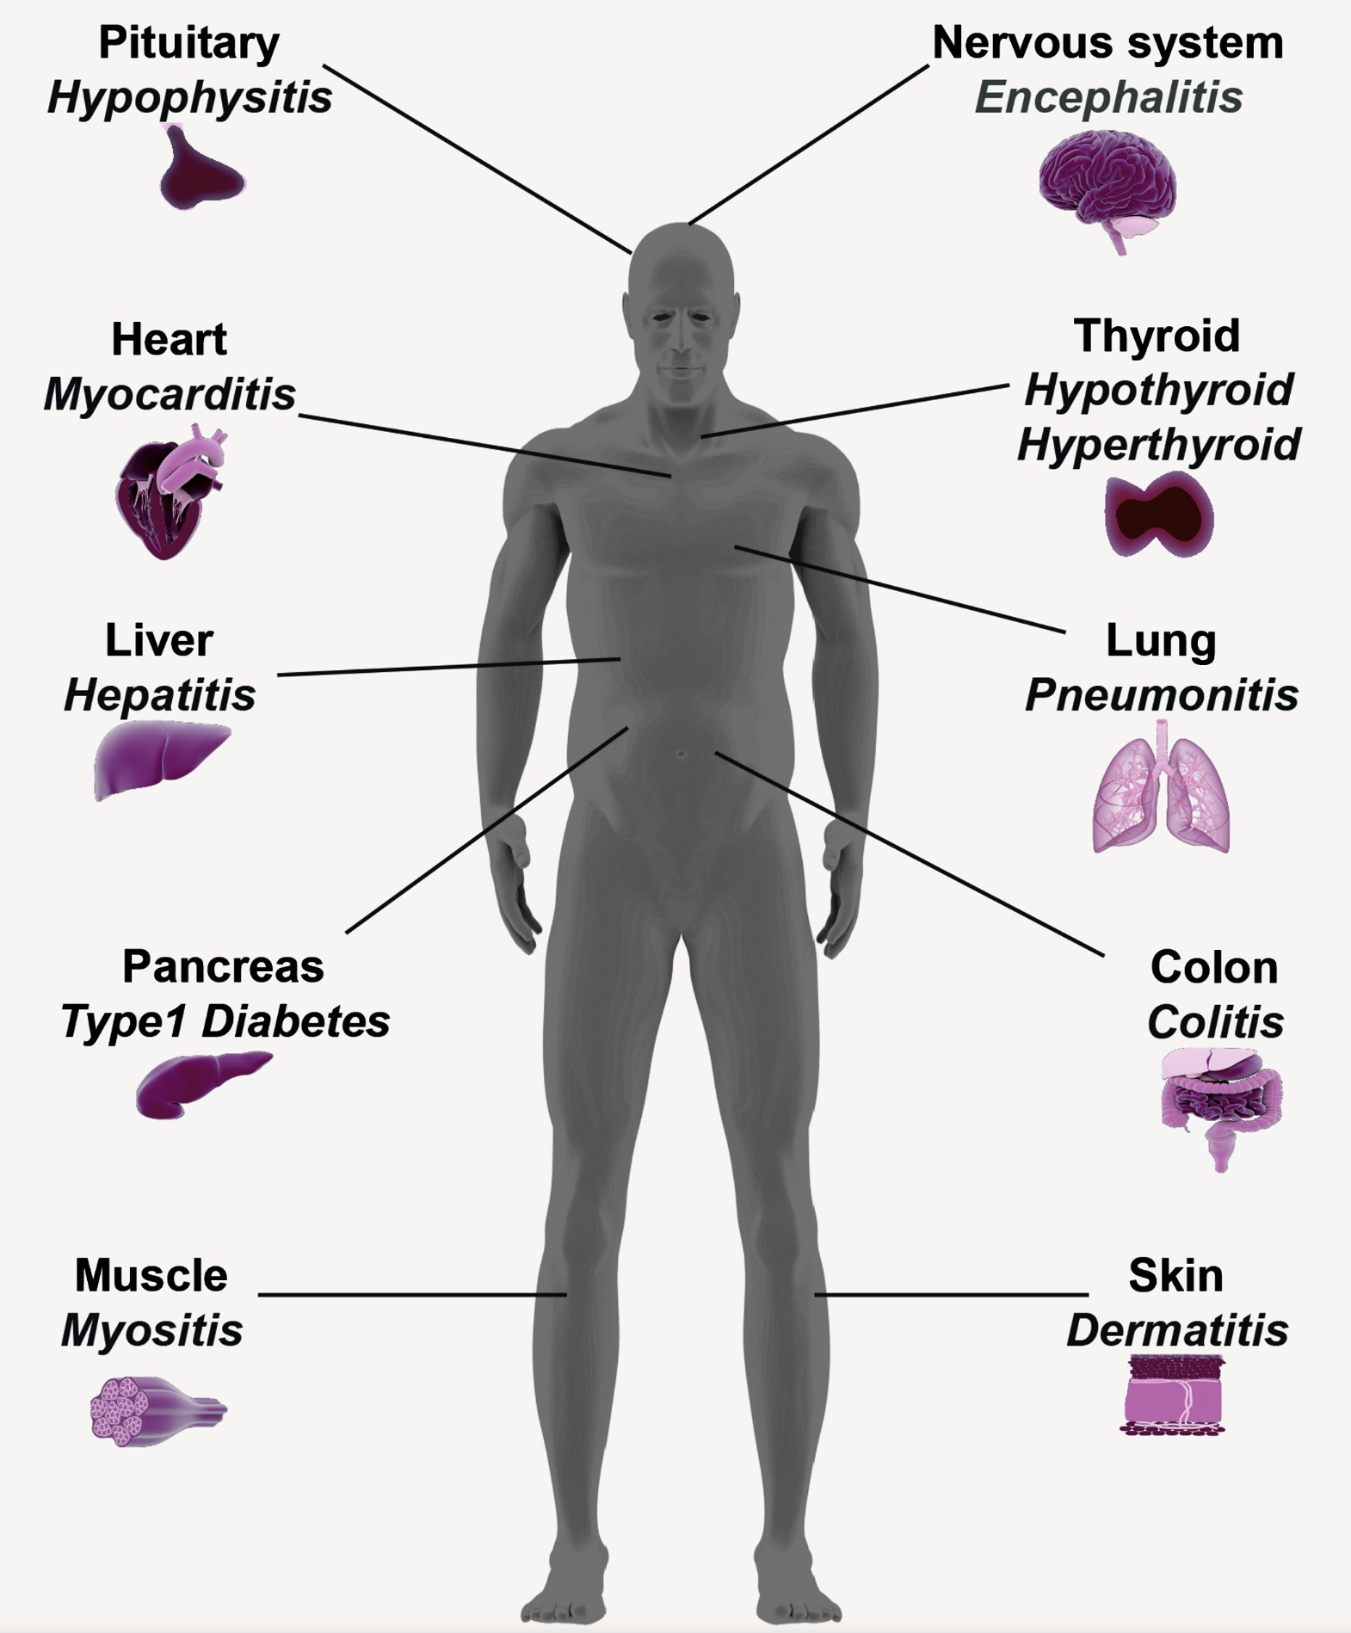
ICB can lead to the development of immune-related adverse events (irAEs)
Khan et al. Semin Cancer Biol. 2020
Notes:
irAEs are autoimmune-like inflammatory pathologies

Slide 6
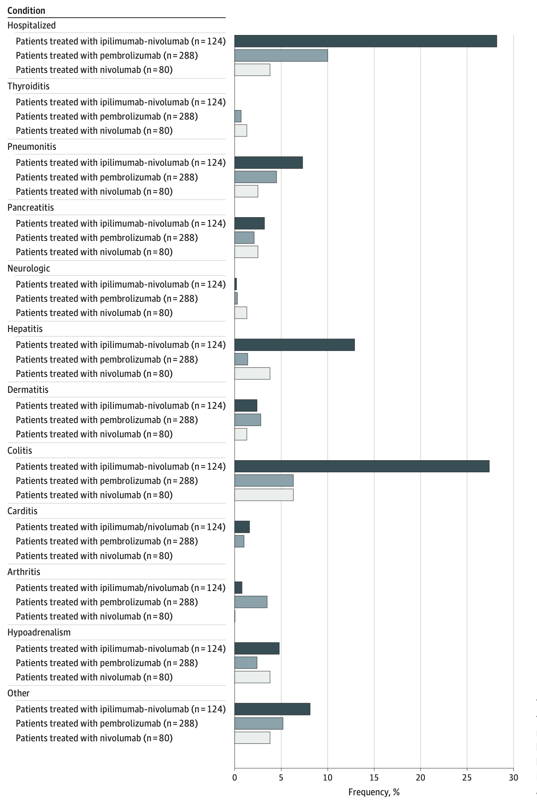
irAEs are rather common and can be severe
Watson et al. JAMA Netw Open. 2022
Notes:
T cell characteristics associated with toxicity to immune checkpoint blockade in patients with melanoma
Autoimmune toxicity occurs in up to 60% of patients treated with immune checkpoint inhibitor (ICI) therapy
Ipilimumab: CTLA-4
Pembrolizumab/nivolumab: PD-1
Perhaps worth trying to make analogy between viral infections preceding autoimmunity and tumor response preceeding irAEs?

Slide 7
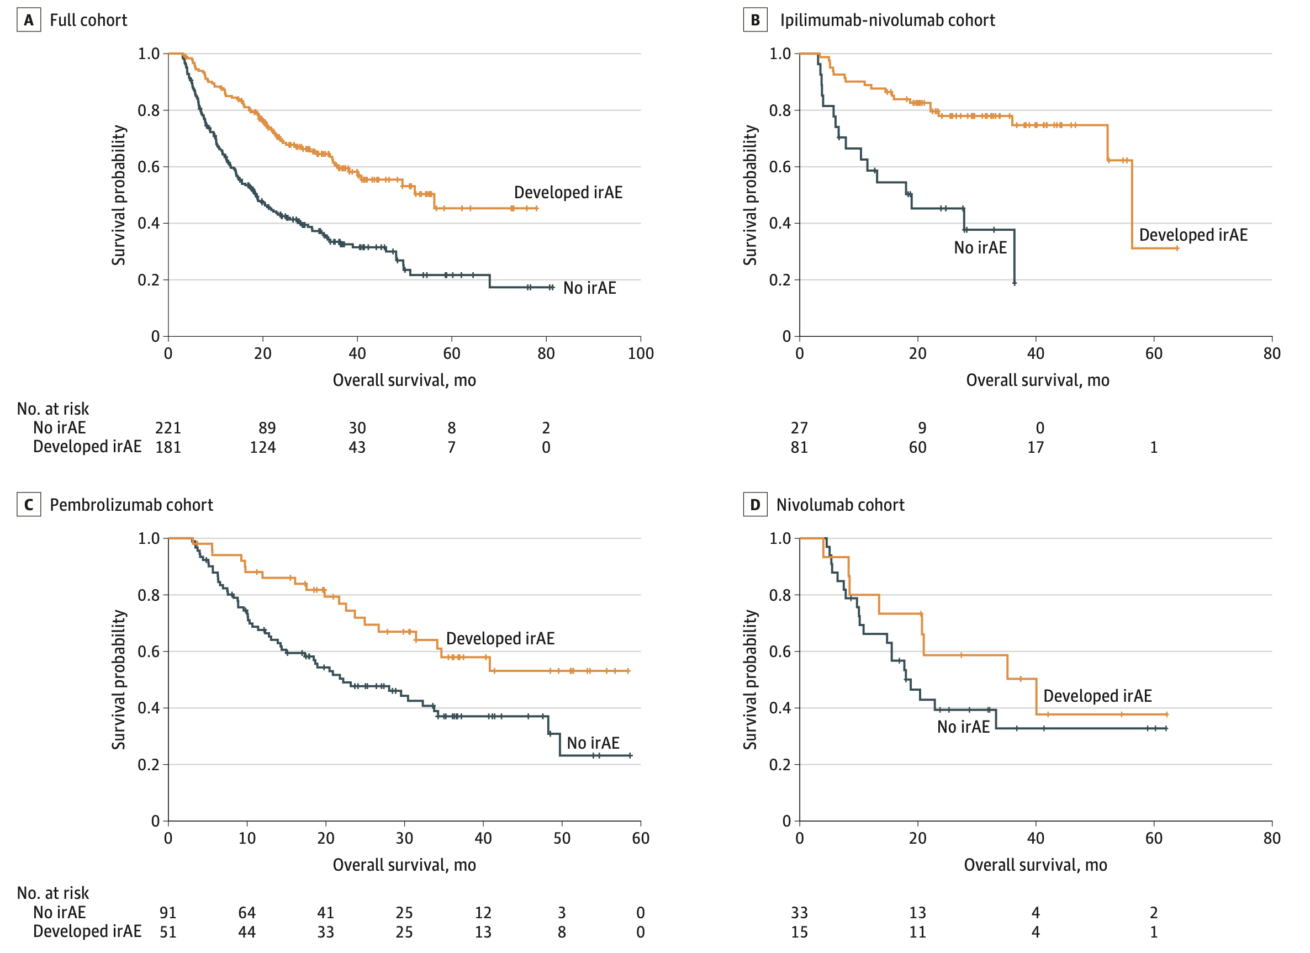
irAE development is associated with anti-tumor response (PMID31021392, PMID26501224, PMID26446948)
Watson et al. JAMA Netw Open. 2022
Notes:
Association of checkpoint inhibitor-induced toxic effects with shared cancer and tissue antigens in non-small cell lung cancer:
irAEs associated with response to therapy (also can cite Association of vitiligo with tumor response in patients with metastatic melanoma treated with pembrolizumab), also Nivolumab in resected and unresectable metastatic melanoma: characteristics of immune-related adverse events and association with outcomes
Characterization of anti-cancer immune response associated with immune-related adverse events in patients with kidney cancer (meeting abstract)
- more irAEs in ICB responders, not a new finding

Slide 8
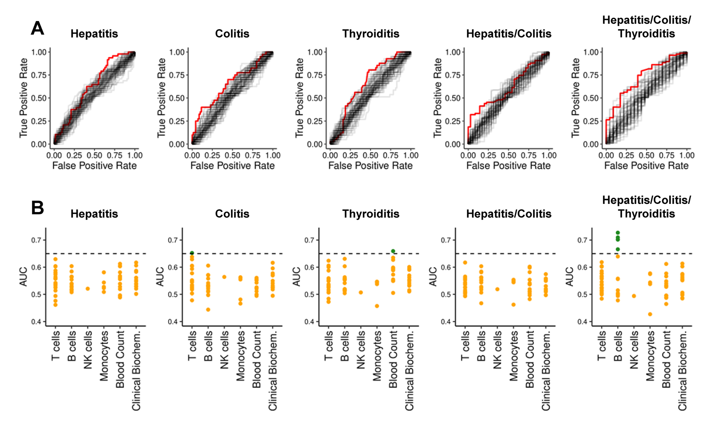
Pre-therapy data generally struggle to reliably predict irAE risk
AUCs for previously reported biomarkers and clinical parameters (68)
Glehr et al. Front Immunol. 2022
Notes:
An AUC of 0.5 suggests no discrimination (equivalent to random guessing), while an AUC of 1 indicates perfect discrimination (for predicting irAE)
heterogeneity amongst irAE organs likely complicates prediction
Germline variants associated with toxicity to immune checkpoint blockade: IL7 cryptic exon, IL7 supports aberrant immune activity in autoimmunity, limits organ toxicity during antiviral immune response, blocks PD-1 leading to T1D (blocking checkpoint when it would have prevented autoimmunity, so IL7 acts as a natural ICB and is therefore rationally associated with irAEs
lower baseline levels of CD8 TCM cells in arthritis irAE patients, higher CD4 Th2 baseline levels in pneumonitis irAE patients, higher CD4 Th17 baseline levels in thyroiditis irAE patients (PMID: 36513074)
low baseline circulating MAITs associated with irAE colitis (PMID: 32734627, ~coincides with my analysis)
activated CD4 TEM abundance (in PBMCs) associated with irAE development (PMID: 35027754, ~disagrees with my analysis)
T cell characteristics associated with toxicity to immune checkpoint blockade in patients with melanoma: BASELINE activated CD4 effector memory T abundance and TCR diversity associated with irAE
# Germline genetic variants are associated with development of insulin-dependent diabetes in cancer patients treated with immune checkpoint inhibitors
- *NLRC5* germline mutation as potential predictive biomarker for T1D irAE

Slide 9
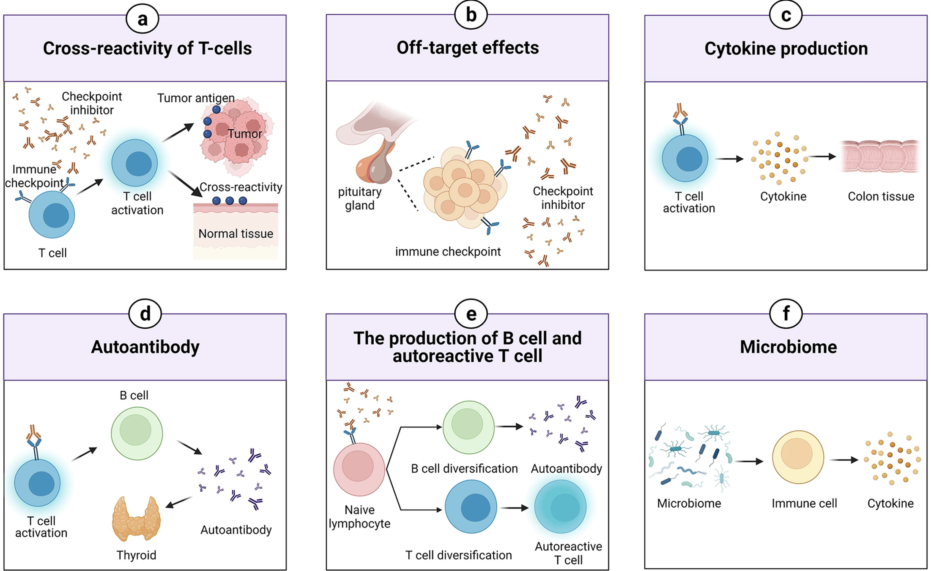
Possible mechanisms driving irAEs
Zheng et al. Materials & Design. 2022
Notes:
TCRs estimated to potentially react with 1 in ~10k encountered peptides (PMID37409132)
Killed tumor cells may release antigens shared by normal cells (i.e. non-tumorigenic proteins still in tumor cell), healthy cells around tumor may also be killed in crossfire and release antigens that induce response
Speculation for what crossreactive T cells are actually targeting, perhaps T cells targeting cancer neoantigens cross-react with WT version of protein in healthy tissue (Autoreactive napsin A-specific T cells are enriched in lung tumors and inflammatory lung lesions during immune checkpoint blockade)
Gouttefangeas et al. Front Immunol. 2023
TCR conceivably could recognize ~ 1 million peptides, crossreactive peptides likely often better agonists than original one that activated T cell, but few (~1%) of peptides are actually presented on MHC, so probably crossreactivity estimate closer to 1 in ~10,000
estimate TCRs to be able to bind ~10^5 to 10^6 peptides (Amino acid similarity accounts for T cell crossreactivity and for "holes" in the T cell repertoire)
What makes TCRs crossreactive? cross-reactivity need not result from sequence similarity (3D structural similarity more important than 1D sequence similarity (Peter’s paper: Autoreactive T cell receptors with shared germline-like α chains in type 1 diabetes)
(b) ICIs can target normal tissues such as hypothalamic and pituitary tissues directly which express immune checkpoint ligand
Pituitary expression of CTLA-4 mediates hypophysitis secondary to administration of CTLA-4 blocking antibody
(c) Activated T cells can release inflammatory mediators which lead to damage in normal tissues
(d) The production of autoantibodies is associated with the risk of irAEs. autoantibodies present ~50% of time for irAEs
(e) ICIs can induce the diversification of lymphocytes as well as promoting T/B cell activation and proliferation
(f) The microbiome with certain bacterial species can shift immune lineage to pro-inflammatory or anti-inflammatory subtypes respectively thereby inducing or resisting irAEs
# Advances in research on molecular markers in immune checkpoint inhibitor-associated myocarditis
- irAE hypotheses: ICIs bind to cell surface proteins (like CTLA-4) in normal tissue leading to T cell infiltration (**this is an obvious one I don't think about much**), crossreactive T cells (T cells recognizing tumor antigens enter circulation and identify similar antigens in healthy tissue), via cytokines (promote infiltration of inflammatory molecules into nontarget tissue, ICIs increase circulating cytokine levels, **this is a good one I don't think about much**), autoantibodies
# B cells as biomarkers: predicting immune checkpoint therapy adverse events
- association between early therapy-induced changes in circulating B cells (decreased B cells, increased plasmablasts and CD21<sup>low</sup>PD-1<sup>+</sup> memory B cells) and an increased risk of high-grade irAEs in patients treated with ICB

Slide 10
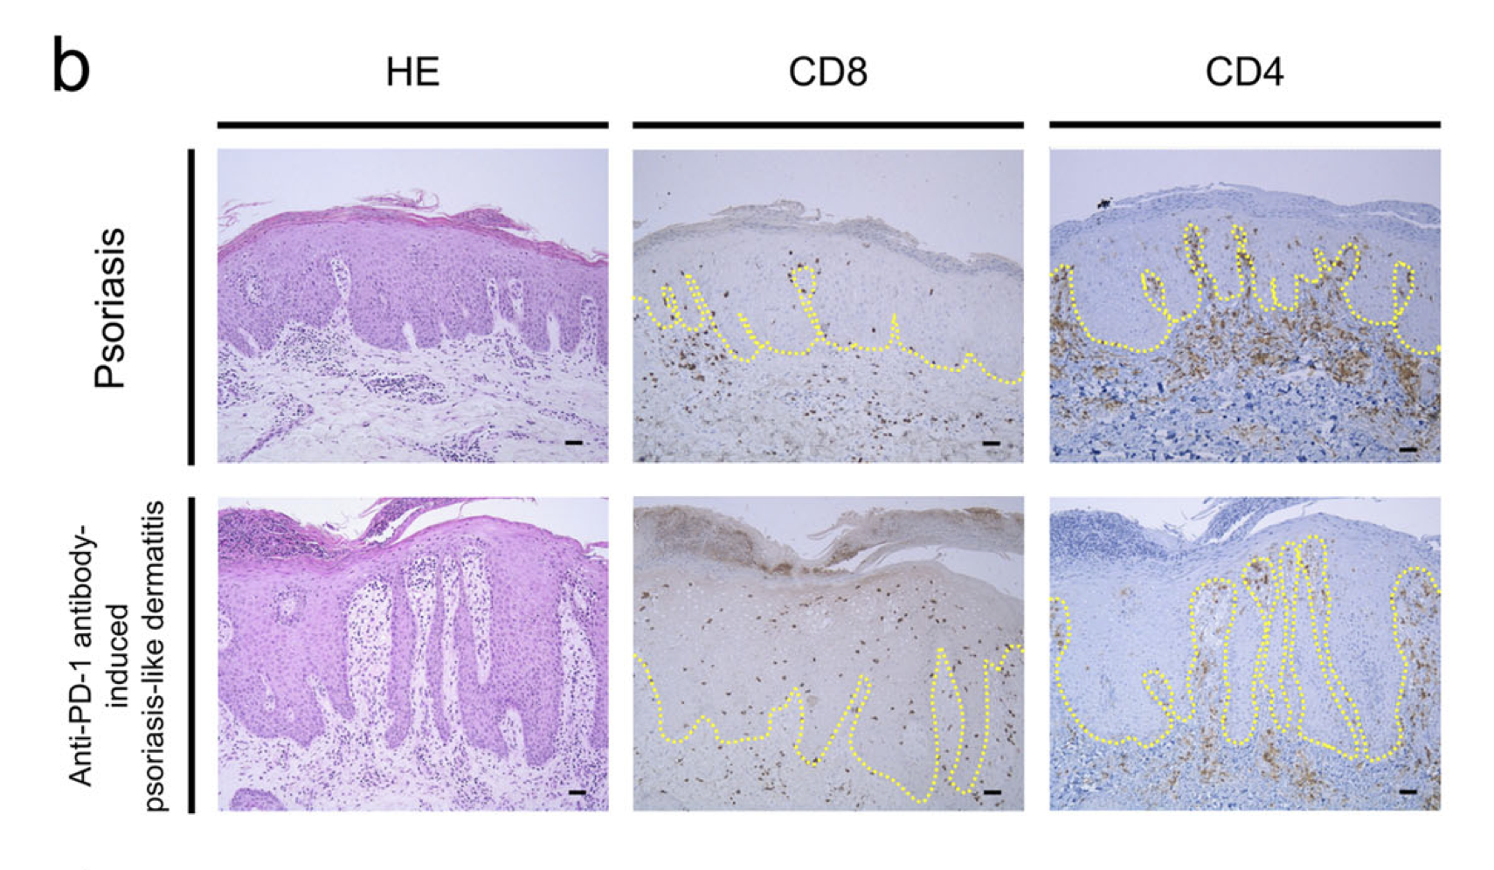
T cells infiltrate irAE tissue (PMID37196065, PMID30832716, PMID27806233, PMID37680638)
Tanaka et al. Commun Biol. 2020

Slide 11
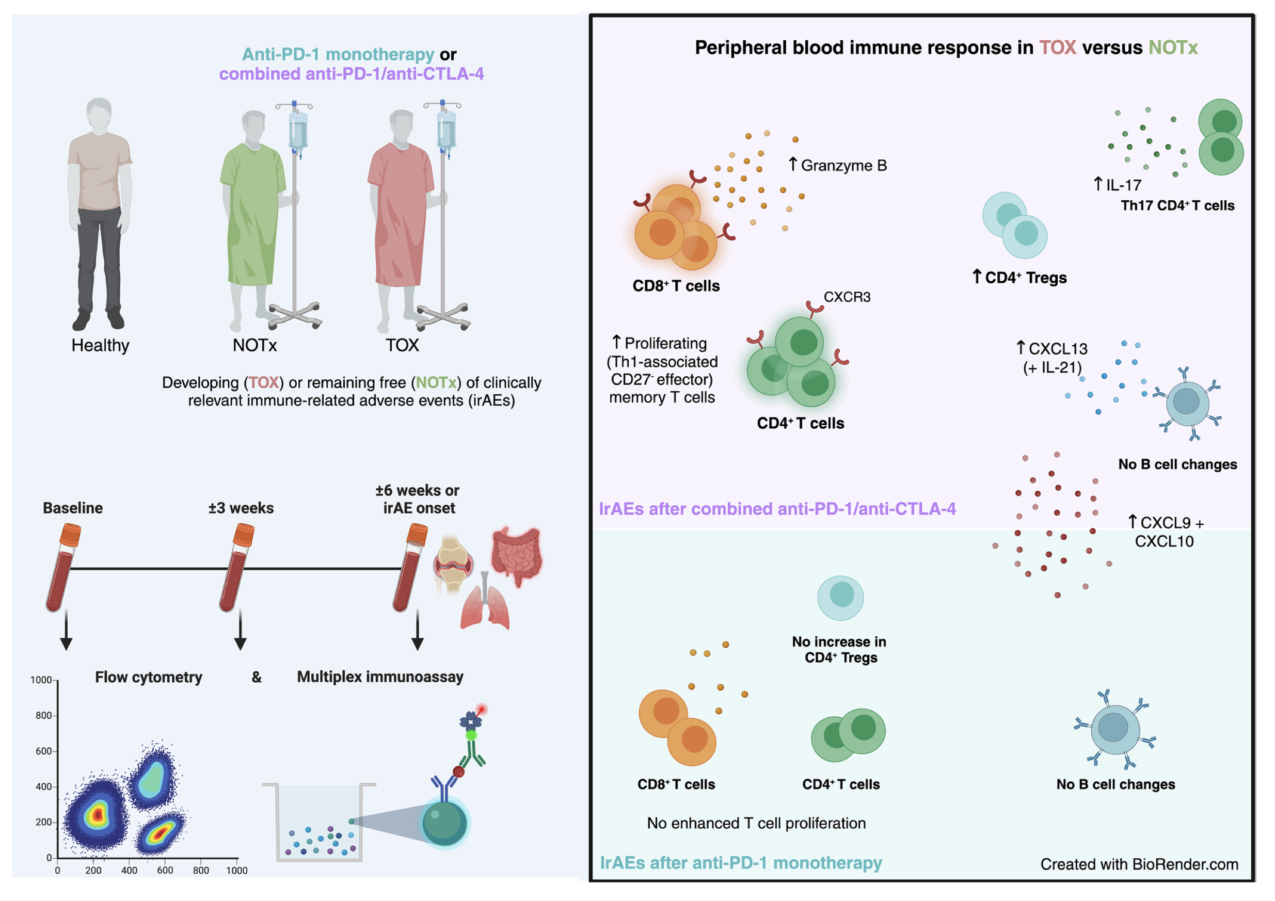
irAEs after combination ICB associated with enhanced proliferation of Th1-associated CD4⁺ TEMs, enhanced cytotoxicity of CD8⁺ T cells
van Eijs et al. Cancer Immunol Immunother. 2023
Notes:
Toxicity-specific peripheral blood T and B cell dynamics in anti-PD-1 and combined immune checkpoint inhibition
IrAEs after cICI were characterized by significantly enhanced proliferation of Th1-associated, mainly (CD4⁺) CD27⁻ effector memory T cells, as well as Th17-associated immune responses and germinal center activation (reflected by CXCL13 and IL-21 increases). We observed no changes in CD21^{lo}, memory, class-switched or newly activated B cell subsets. Particularly double-positive PD-1⁺LAG-3⁺ CD8⁺ T cells showed enhanced cytotoxic capacity in patients with irAEs after cICI. Within anti-PD-1 monotherapy, irAEs were associated with modestly enhanced Th1-associated responses reflected by increased serum CXCL9 and CXCL10. In conclusion, ICI-induced toxicity is dominated by enhanced Th1-associated responses, but in cICI we also found evidence for Th17-associated responses and germinal center activation. Together, our data add to the growing body of evidence that irAEs may be driven by newly activated CD4⁺ helper T cells, specifically after cICI.

Slide 12
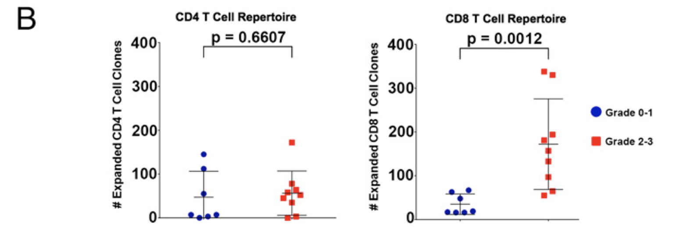
On CTLA-4 blockade (CD8) T cell expansion, repertoire diversification may be associated with irAE development (PMID28031229)
Subudhi et al. PNAS 2016
Notes:
I didn’t mine this dataset as it was flow not RNA… could still do it but initially focused on RNA+TCR so I could analyze gene expression profiles if I wanted to (not that I really did that much…)
Statistics caveat: not necessarily more TCR diversification in irAE group on ICI just because we saw significance in irAE group and not in no irAE group
Biomarkers of checkpoint inhibitor induced immune-related adverse events - a comprehensive review: on treatment markers including clonal expansion of more T cell clones, more newly emerging T cell clones, decline in T cell clonality all very interestingly associated with more irAEs
Checkpoint blockade-induced dermatitis and colitis are dominated by tissue-resident memory T cells and Th1/Tc1 cytokines
Clinical outcome following checkpoint therapy in renal cell carcinoma is associated with a burst of activated CD8 T cells in blood: model: pool of tumor-specific TCF-1<sup>+</sup> stem-like CD8 T cells that aren't proliferating or generating antitumor effector cells that are a reservoir unleashed by ICB, seen by large burst of HLA-DR<sup>+</sup> CD38<sup+</sup> CD8 T cells after ICB and new repertoire
clonal replacement: recruitment of less dysfunctional peripheral T cell clonotypes to tumor that were not detectable in tumor prior to PD-1 blockade, i.e. from tumor draining lymph node, more important in ICI than previously thought
clonal revival: replenishment of highly dysfunctional T cell clones in tumor with new, less dysfunctional T cells (perhaps from periphery, local expansion within tumor) that can be novel clonotypes (i.e. clonal replacement) or clonotypes pre-existing in tumor
Distinct cellular mechanisms underlie anti-CTLA-4 and anti-PD-1 checkpoint blockade
- PD-1 blockade predominantly induces expansion of specific tumor infiltrating exhausted-like CD8<sup>+</sup> T cell subsets
- CTLA-4 blockade induces expansion of ICOS<sup>+</sup> Th1-like CD4<sup>+</sup> effector T cells, also engages specific subsets of exhausted-like CD8<sup>+</sup> T cells
Immune-related adverse events in checkpoint blockade: observations from human tissue and therapeutic considerations
PD-1 blockade more CD8 effect, CD4 effect more for CTLA-4 blockade
Oh et al. Cancer Res. 2018
CTLA-4 blockade induced greater diversification of T cell repertoire (more clonotypes including newly detected clones, decreased clonality) in irAE patients compared to no irAE patients
Subudhi et al. Proc Natl Acad Sci USA, 2016
CD8 T cell clonal expansion was greater in patients developing severe irAEs
Early rise in brain damage markers and high ICOS expression in CD4+ and CD8+ T cells during checkpoint inhibitor-induced encephalomyelitis
costimulatory receptor inducible T cell costimulatory receptor (ICOS) was expressed on a high proportion of CD4+ and CD8+T cells as encephalomyelitis symptoms peaked and then gradually decreased in parallel with clinical improvement. Both single and double immune checkpoint inhibitor-treated melanoma patients with other serious immune-related adverse events (irAE) (n=9) also expressed ICOS on a significantly higher proportion of CD4+ and CD8+T cells compared with controls without irAE (n=12). In conclusion, our results suggest a potential role for ICOS on CD4+ and CD8+T cells in mediating encephalomyelitis and other serious irAE.
Immune signatures predict development of autoimmune toxicity in patients with cancer treated with immune checkpoint inhibitors
Specifically, an early increase in CXCL9/CXCL10/CXCL11 and interferon-γ (IFN-γ) 1 to 2 weeks after the start of therapy are likely indicators of heightened risk of developing irAEs. In addition, an early expansion of Ki-67⁺ regulatory T cells (Tregs) and Ki-67⁺ CD8⁺ T cells is also likely to be associated with increased risk of irAEs.
Yano [98]
HLA-DR15 is significantly higher in patients with pituitary irAE than in healthy controls, which may be a predisposing factor for pituitary irAE. The mechanism may be that HLA-DR15 mediated IL-17
New biomarkers exploration and nomogram construction of prognostic and immune-related adverse events of advanced non-small cell lung cancer patients receiving immune checkpoint inhibitors
CD3+CD56+CD16+NKT-like cells were not only correlated with PFS but also associated with severe irAEs
Toxicity-specific peripheral blood T and B cell dynamics in anti-PD-1 and combined immune checkpoint inhibition
IrAEs after cICI were characterized by significantly enhanced proliferation of Th1-associated, mainly (CD4⁺) CD27⁻ effector memory T cells, as well as Th17-associated immune responses and germinal center activation (reflected by CXCL13 and IL-21 increases). We observed no changes in CD21^{lo}, memory, class-switched or newly activated B cell subsets. Particularly double-positive PD-1⁺LAG-3⁺ CD8⁺ T cells showed enhanced cytotoxic capacity in patients with irAEs after cICI. Within anti-PD-1 monotherapy, irAEs were associated with modestly enhanced Th1-associated responses reflected by increased serum CXCL9 and CXCL10. In conclusion, ICI-induced toxicity is dominated by enhanced Th1-associated responses, but in cICI we also found evidence for Th17-associated responses and germinal center activation. Together, our data add to the growing body of evidence that irAEs may be driven by newly activated CD4⁺ helper T cells, specifically after cICI.

Slide 13
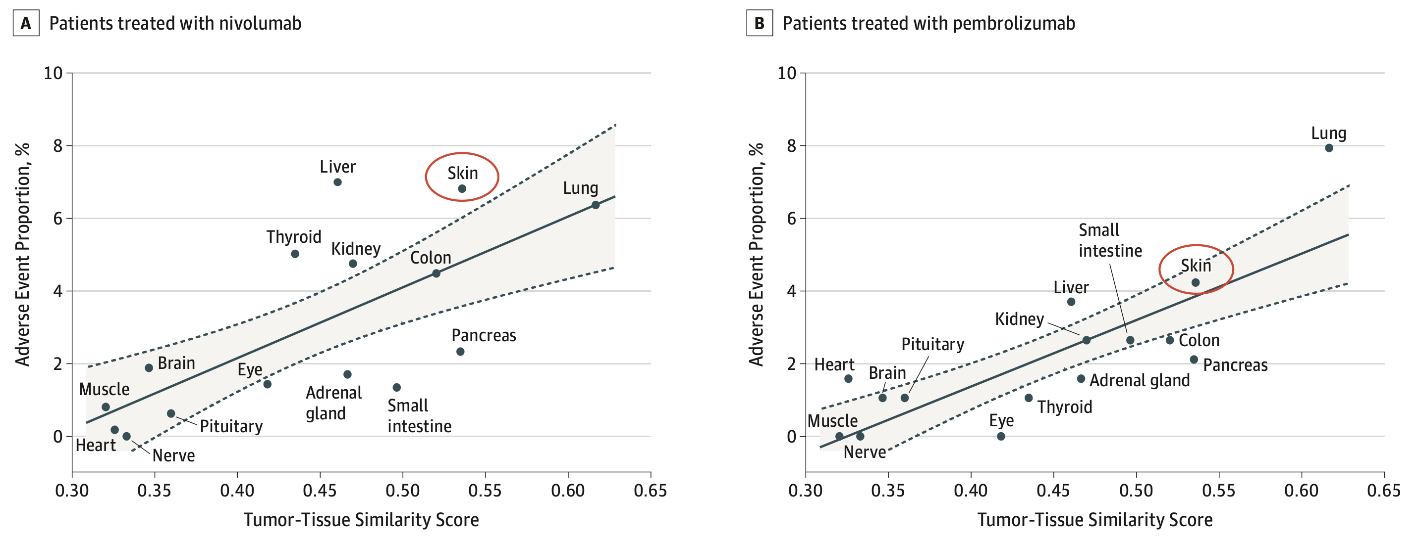
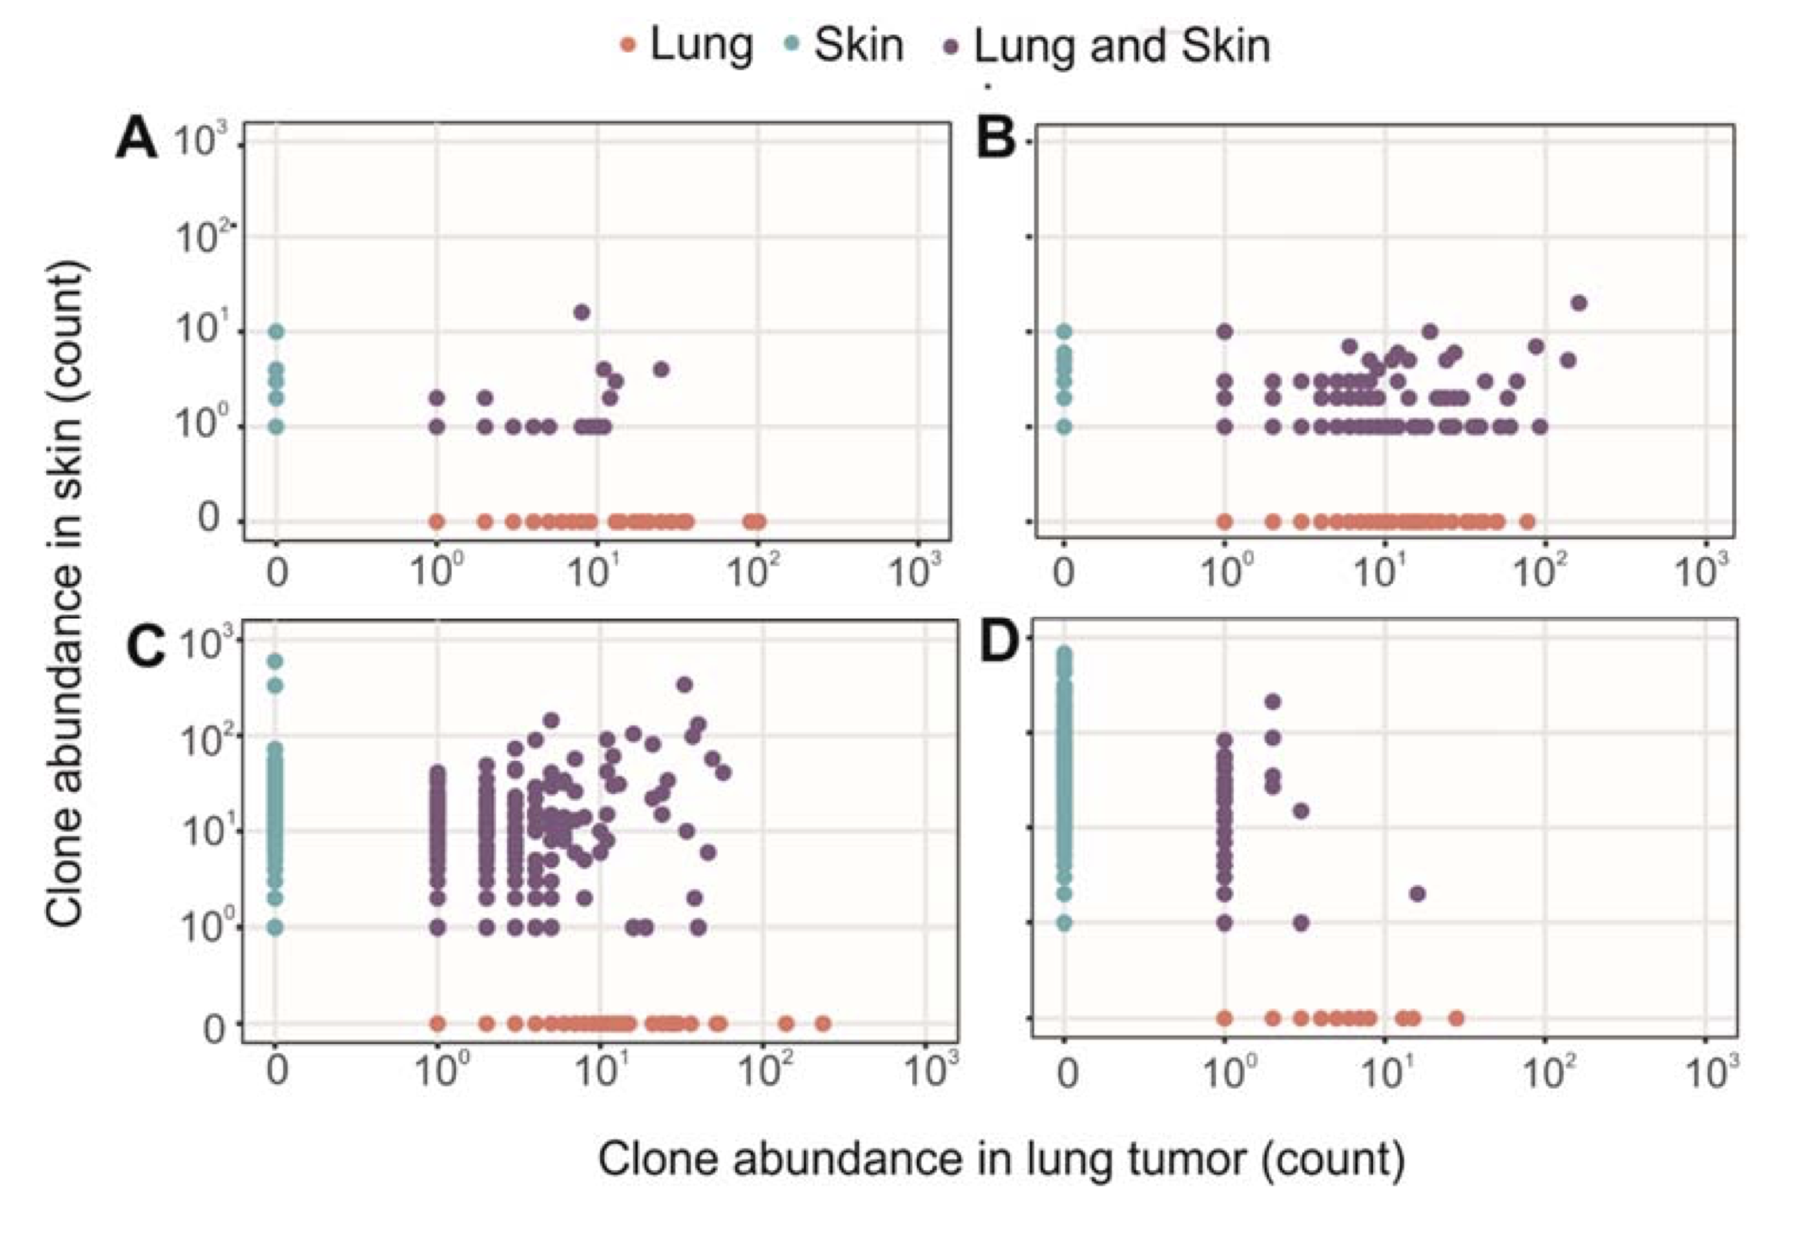
Organs more similar to (lung) tumor have higher irAE incidence rates, TCR sharing between (lung) tumor and (skin) irAE tissue (PMID27806233)
Berner et al. JAMA Oncology, 2019
Notes:
infiltration of T cells in irAE tissue (PMID31021392, PMID35101349)
sharing between TCR clonotypes infiltrating primary tumor and irAE tissue (PMID31021392, PMID30832716) and metastases and irAE tissue (PMID37680638)
more peripheral T cell clones shared with TILs in irAE patients (PMID30832716)
Similarity score calculation: basically look at comparison between RNA from normal tissue (Genotype-Tissue expression GTEx database) and RNA from tumors (NSCLC libraries from TCGA)

Slide 14
Goals
Investigate relationship between on-therapy cell type abundances, TCR repertoire diversities and irAE development
Determine if TCR (junction) features can serve a proxy for or predispose to T cell cross-reactivity
Features to investigate
Junction length (PMID33289628, PMID12152083, PMID9597140), chemical properties (PMID35177831)
TCR germline-ness (probability of generation)
Possible effects of feature variations
Altered TCR-pMHC contact geometry, binding modes, number of contacts
Mine datasets for other T cell differences between patients developing and not developing irAEs
Notes:
Additional possible effect that I’m not sure how to talk about: altered diversity?
Initially thought that more germline-like TCRs might be more cross-reactive as they have lower sequence complexity, don’t fully understand that hypothesis though…
Hydrophobicity: more hydrophobic TCRs might be more cross-reactive as they allow more alternative contacts
Entropic contributions and the influence of the hydrophobic environment in promiscuous protein-protein association: interface demonstrates promiscuity in part due to the number of interactions this hydrophobic interface allows, which allows many alternative contacts (increased entropy, drives forward binding) with other binding partners hence promiscuity
Repertoire analyses reveal T cell receptor sequence features that influence T cell fate
TRB CDR3 hydrophobicity promotes reactivity to self-peptides
Functionally specialized human CD4+ T cell subsets express physiochemically distinct TCRs: longer CDR3s might promote crossreactivity
Statistical analysis of CDR3 length distributions for the assessment of T and B cell repertoire biases:
The length of the CDR3 loop greatly influences its shape and ability to fold both on itself and in the company of others loops such as the CDR1 and CDR2

Slide 15
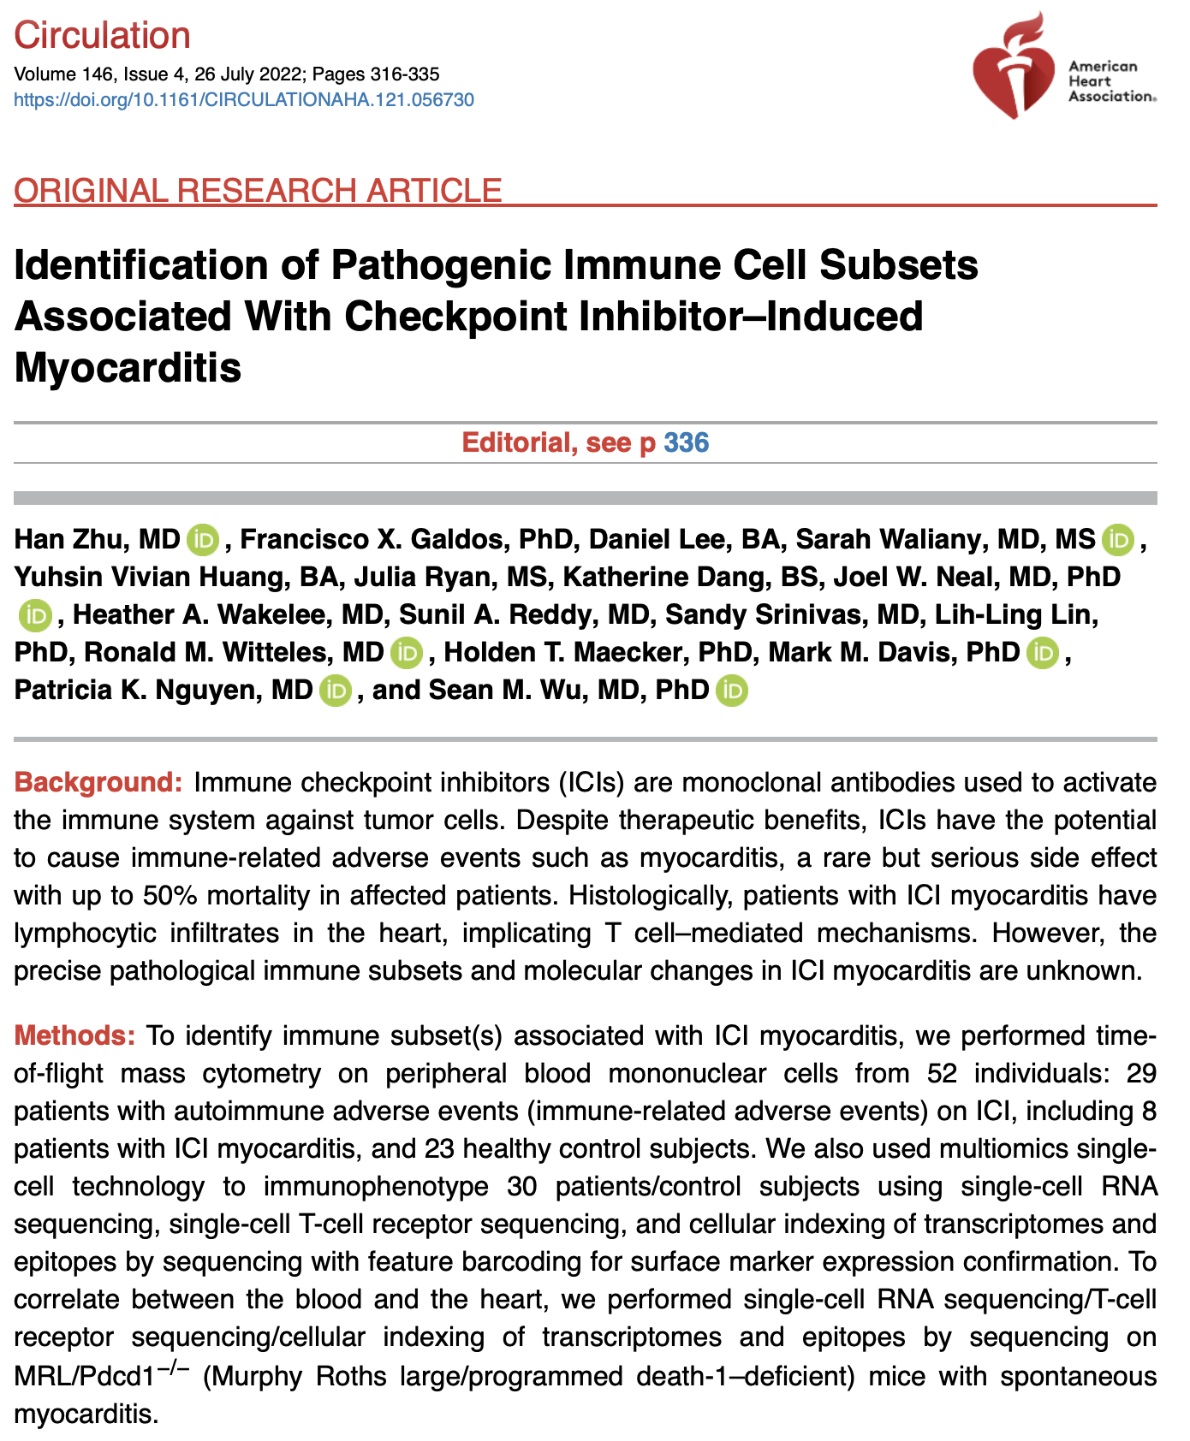
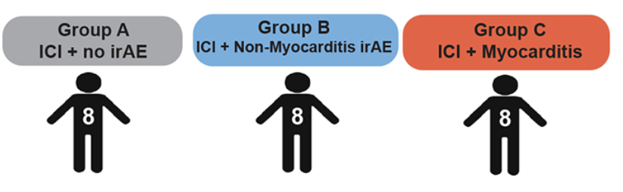
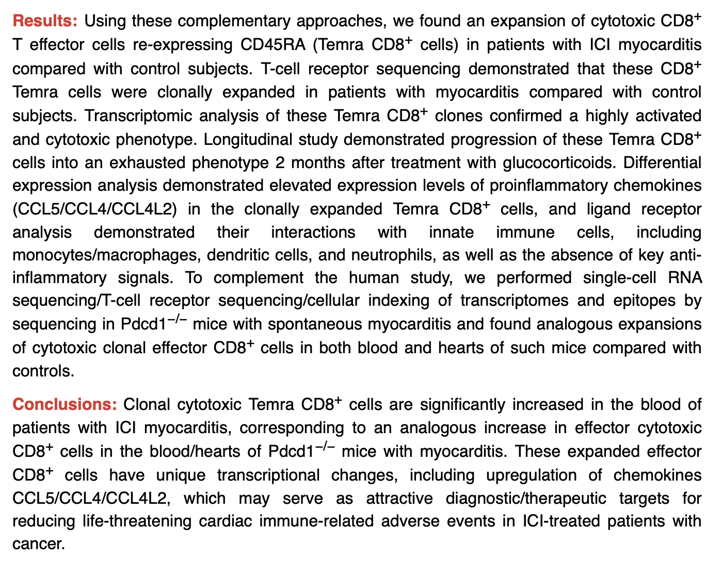
I pooled groups B & C for power
PMBCs
from patients
with diverse
tumor types
mostly treated
with PD-1
blockade
Notes:
Seq details:
Sequencing of all 10x Genomics libraries was performed through Medgenome (Foster City,
California). 5’ library, TCR library, and feature barcoding libraries were all sequenced on the Illumina
NovaSeq 6000 instrument using 200 cycle kits and run with 2x100bp for a goal of 20,000 paired
reads/cell, 5,000 paired reads/cell, and 5,000 paired reads/cell. Ultimately, 30,000-60,000 mean reads
per cell were achieved in each sample, in order to achieve sufficient sampling of genes
Clusters of cell populations were marked according to differentially expressed markers of each queried cluster and established canonical markers of each immune subset
More PD-1 blockade it seems
Time on ICI:
~ 6-12 months on ICI before blood
~ few months from symptom onset to blood

Slide 16
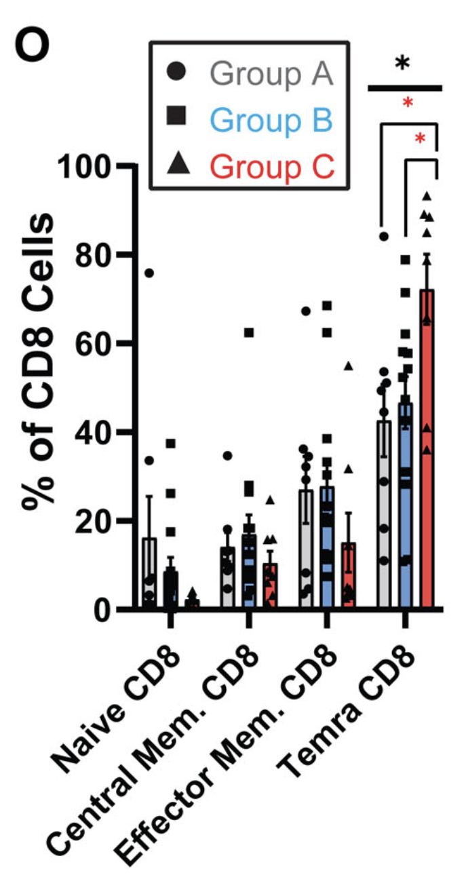
PBMC myocarditis-focused dataset
Main conclusion of theirs
Within myocarditis only irAE group (C), observe more Temra CD8s (called via CyTOF/CITE-seq + RNA) and upregulated chemokines CCL5/CCL4/CCL4L2

Slide 17
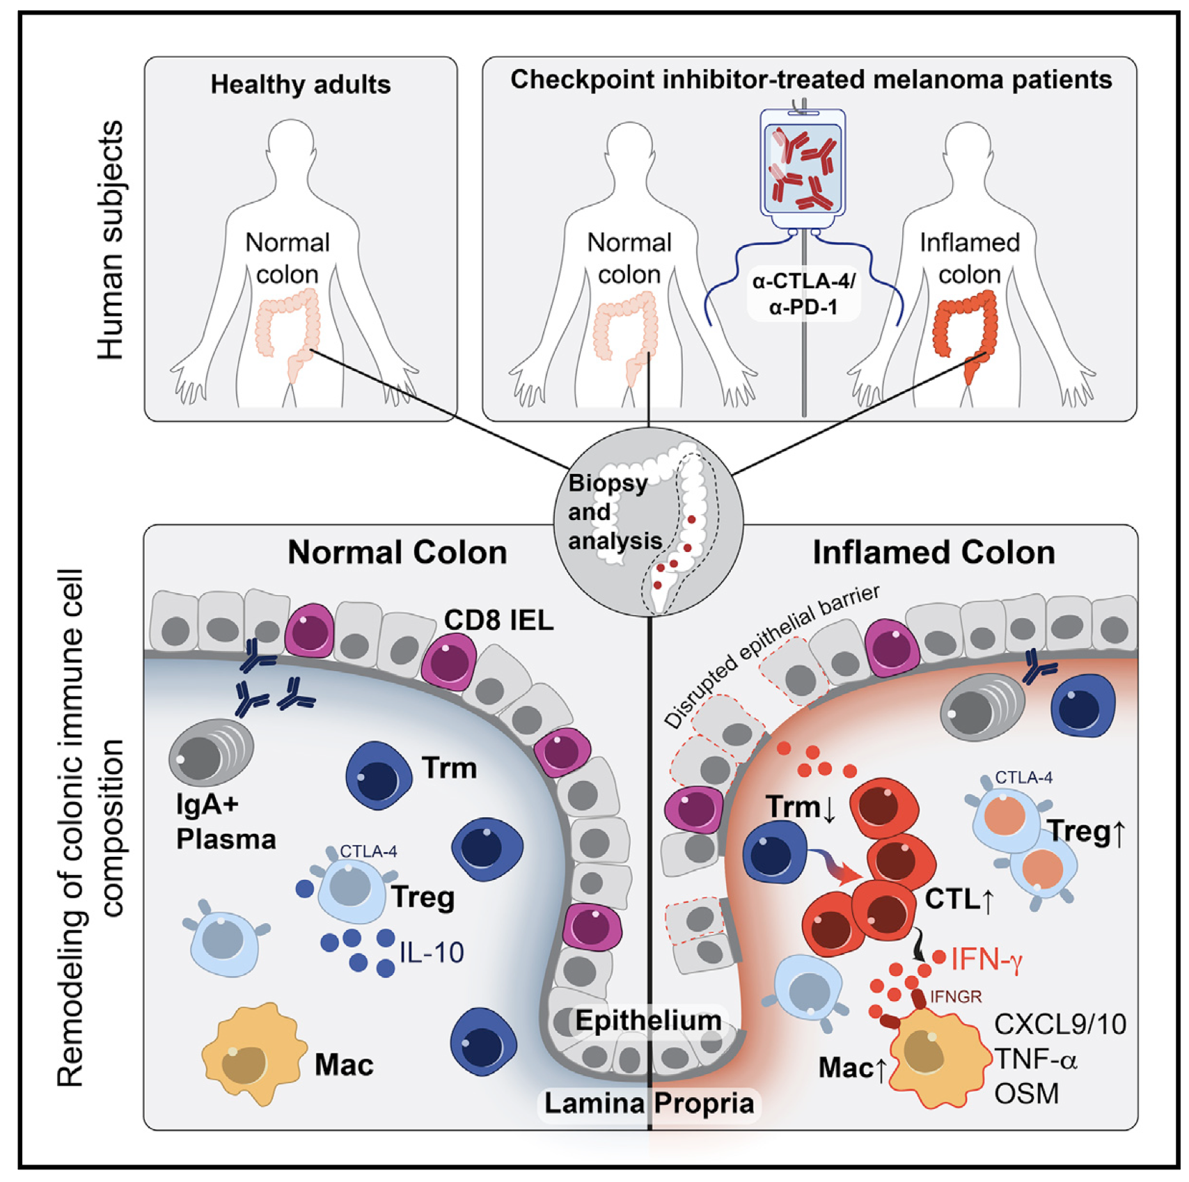
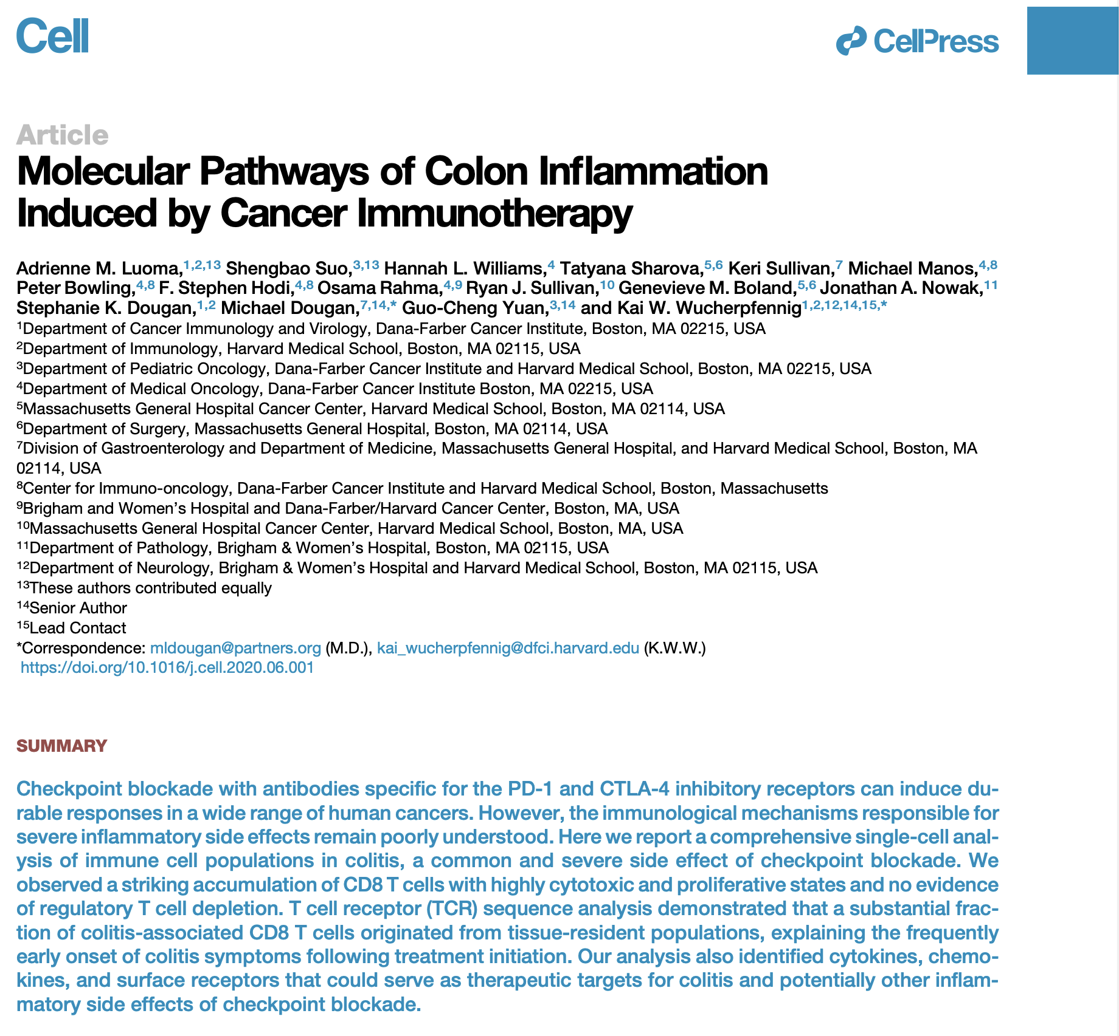
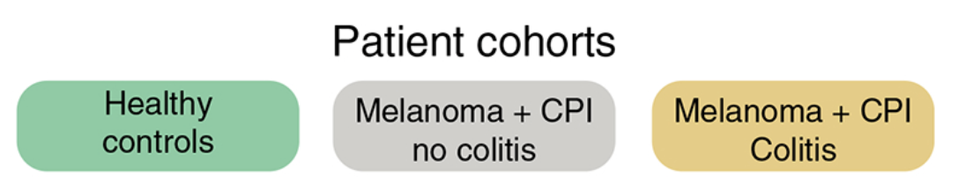
n = 8 n = 6 n = 8
Colon tissue from melanoma patients treated with CTLA-4 blockade (or combo)
Notes:
Colitis seq details:
Sequencing of scRNA-seq libraries
CD3⁺ T cell gene expression libraries were sequenced on the Illumina HiSeq 4000 platform with 150 bp paired-end read configuration. CD45+ MNC libraries were sequenced either on the Illumina HiSeq 4000 platform with 150 bp paired-end read configuration or the HisSeq 2500 platform on rapid run mode. We obtained >30,000 reads per cell for all samples, which was particularly important with CD45+ libraries for sufficient sampling of non-immunoglobulin genes given the high plasma B cell count. TCR V(D)J libraries were sequenced on the Illumina MiSeq (V2 flowcell), HiSeq 2500, or HiSeq 4000 platform, all on 150 bp paired-end read configuration.
Cell mapping:
We used two complementary approaches to annotate the identities of different cell clusters: (1) we checked whether the well-studied marker genes of different immune cell types were in the top rank of differential expressed genes of query cluster and then assigned the most likely identity for each cell cluster; (2) applied an unbiased cell type recognition method named SingleR (v0.99.10, R package) (Aran et al., 2019), which leverages reference transcriptomic datasets of known cell types for annotation (Martin et al., 2019; Smillie et al., 2019). We first applied SingleR to determine if the predicted annotations for a query cluster based on different reference datasets were consistent, and then assigned this cluster as the predicted cell type annotation; alternatively, we checked which genes were in the top rank of differentially expressed gene list of this cluster
More CTLA-4 blockade it seems
Time on ICI:
most ~1-2 treatment cycles
~1 month from treatment start before symptoms
~2 weeks from treatment end before symptoms
~ few days after symptoms before endoscopy

Slide 18
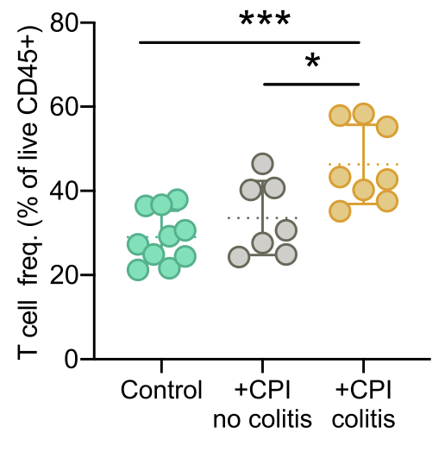
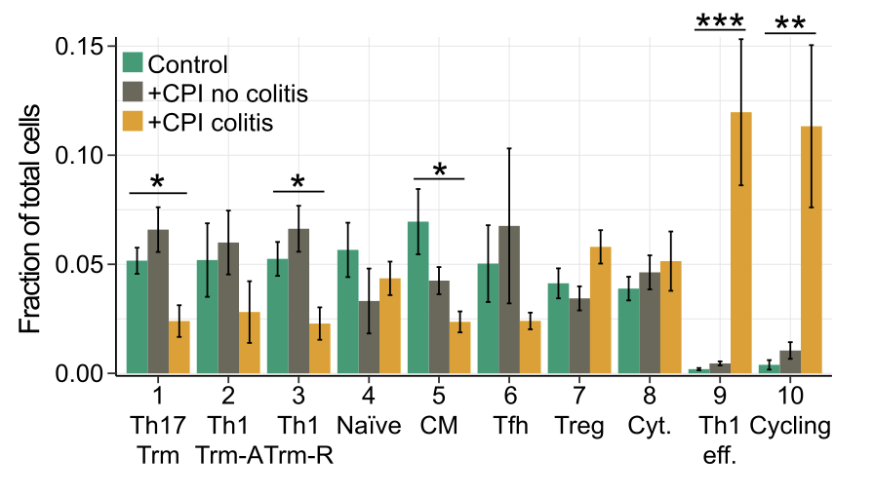
Main conclusions of theirs from colon tissue colitis dataset: higher T cell fraction in irAE group, CD4 T cell subtype abundance differences by irAE group
CD4 T cells

Slide 19
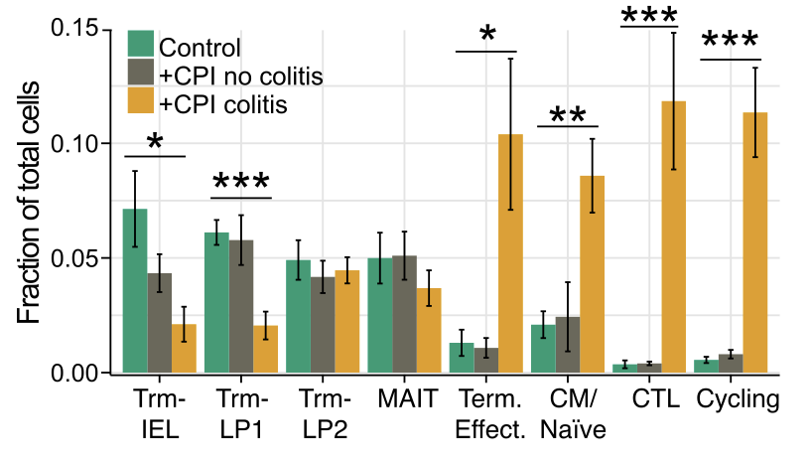
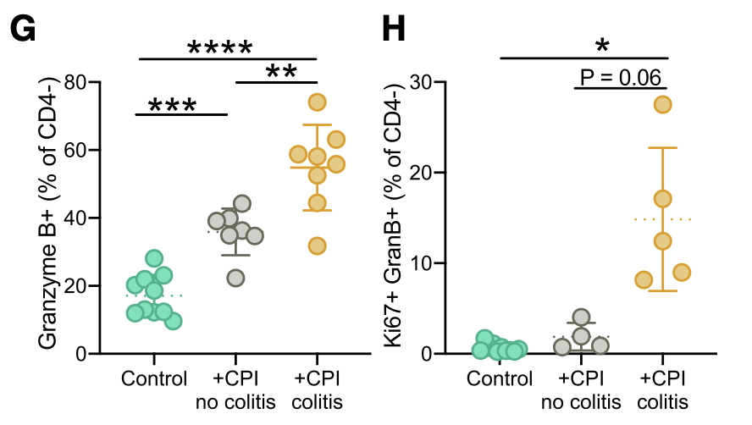
Main conclusions of theirs from colon tissue colitis dataset: CD8 T cell subtype abundance differences by irAE group, CD8 T cells more cytotoxic and slightly more proliferative in irAE group
CD8 T cells
Notes:
More CD8 prolifs seen elsewhere too in irAE group:
Immune signatures predict development of autoimmune toxicity in patients with cancer treated with immune checkpoint inhibitors
Specifically, an early increase in CXCL9/CXCL10/CXCL11 and interferon-γ (IFN-γ) 1 to 2 weeks after the start of therapy are likely indicators of heightened risk of developing irAEs. In addition, an early expansion of Ki-67⁺ regulatory T cells (Tregs) and Ki-67⁺ CD8⁺ T cells is also likely to be associated with increased risk of irAEs

Slide 20
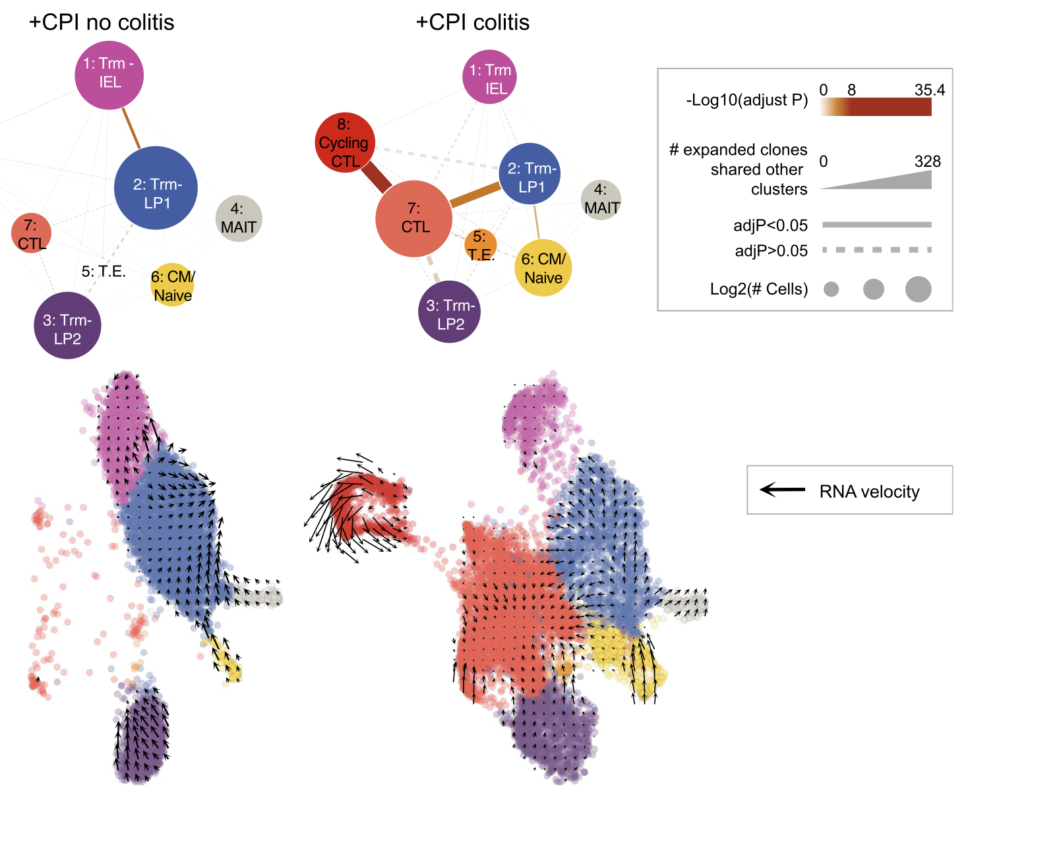
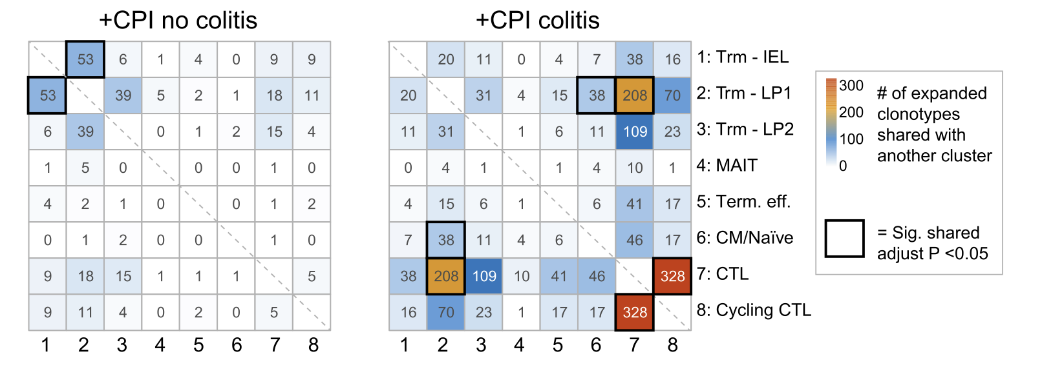
Main conclusions of theirs from colon tissue colitis dataset: TCR sharing between CD8 Trm and CTL clusters suggests that CD8s in colon tissue arose from Trm populations
Notes:
The bubbles are a visualization of the heatmaps as a network plot (nodes are cell clusters, size are counts, widths of connecting lines are shared clonotypes)

Slide 21
Unanswered question from these two datasets
Do TCRs from those with irAEs differ in features from those without irAEs?

Slide 22
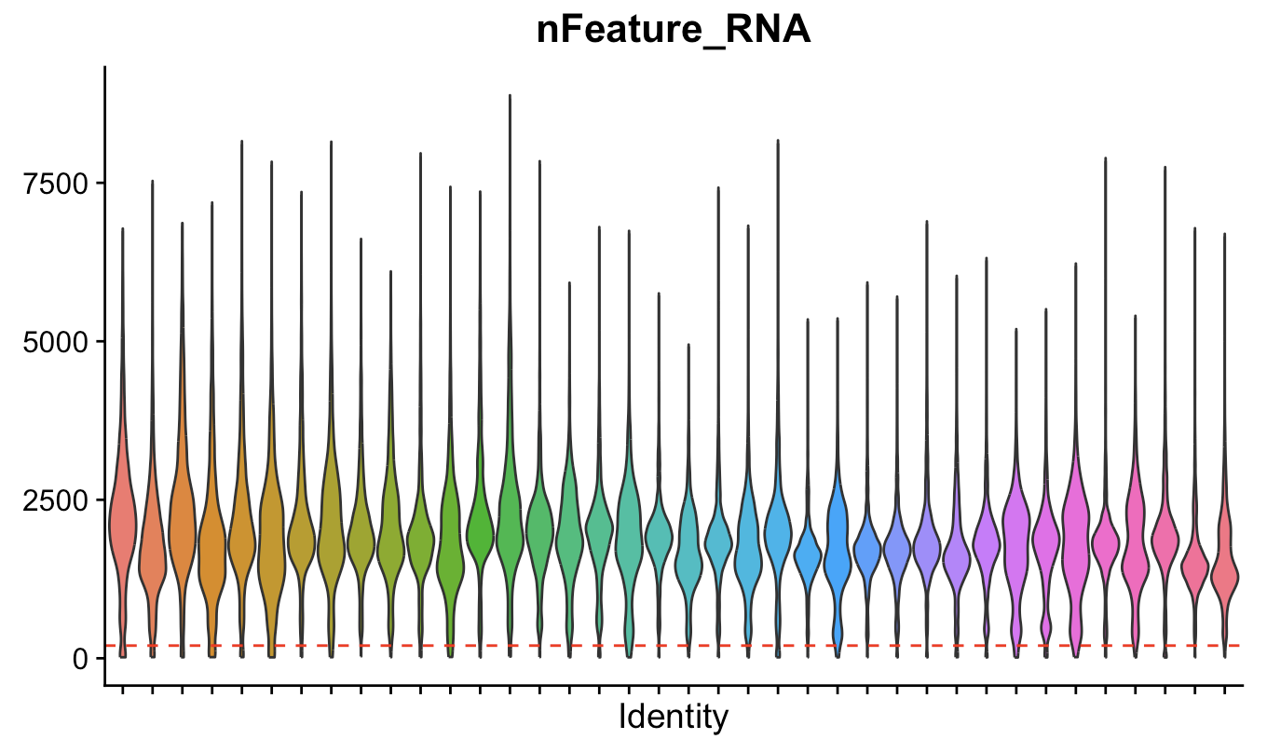
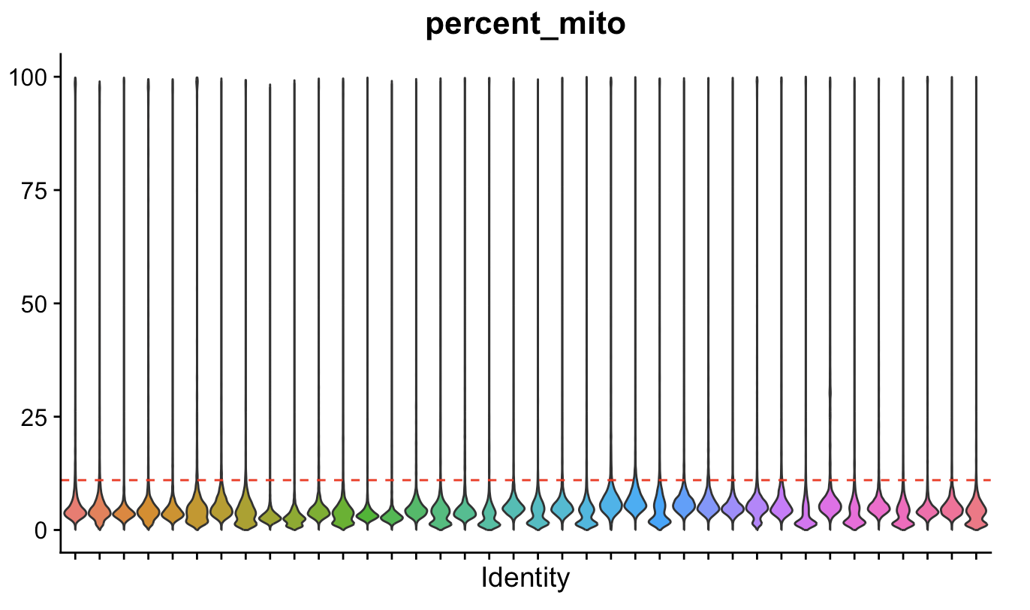
QC (colon tissue colitis dataset)
Patient ID
Patient ID
~129k cells remain after QC (~13k cells dropped),
~180k cells remain after QC (~50k cells dropped) in PBMC myocarditis-focused dataset
Notes:
Colitis: "nFeature_RNA_min" = 200,
"percent_mito" = 11
Myocarditis: mtRNA < 15%
500 unique RNAs/cell

Slide 23
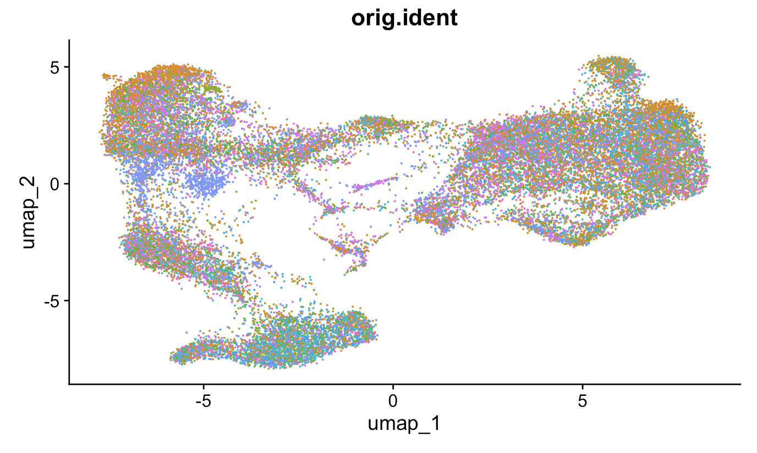
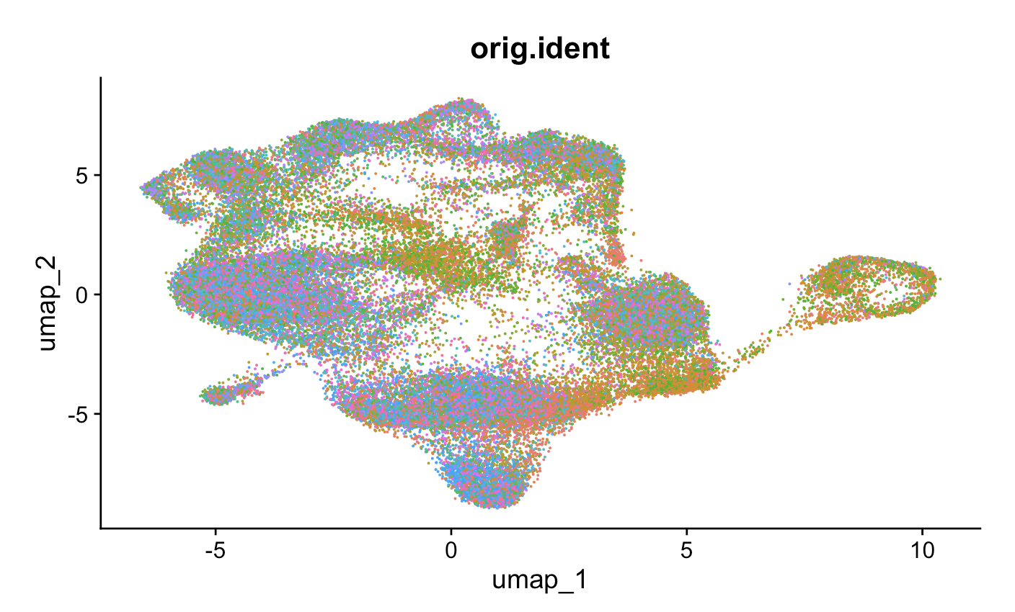
Data normalization, highly variable feature selection, data scaling, dimensional reduction
PBMC myocarditis-focused dataset
Colon tissue colitis dataset
Patient ID
Patient ID
Notes:
Normalize:
that normalizes the feature expression measurements for each cell by the total expression, multiplies this by a scale factor (10,000 by default), and log-transforms the result
Scaling:
Shifts the expression of each gene, so that the mean expression across cells is 0
Scales the expression of each gene, so that the variance across cells is 1
This step gives equal weight in downstream analyses, so that highly-expressed genes do not dominate

Slide 24
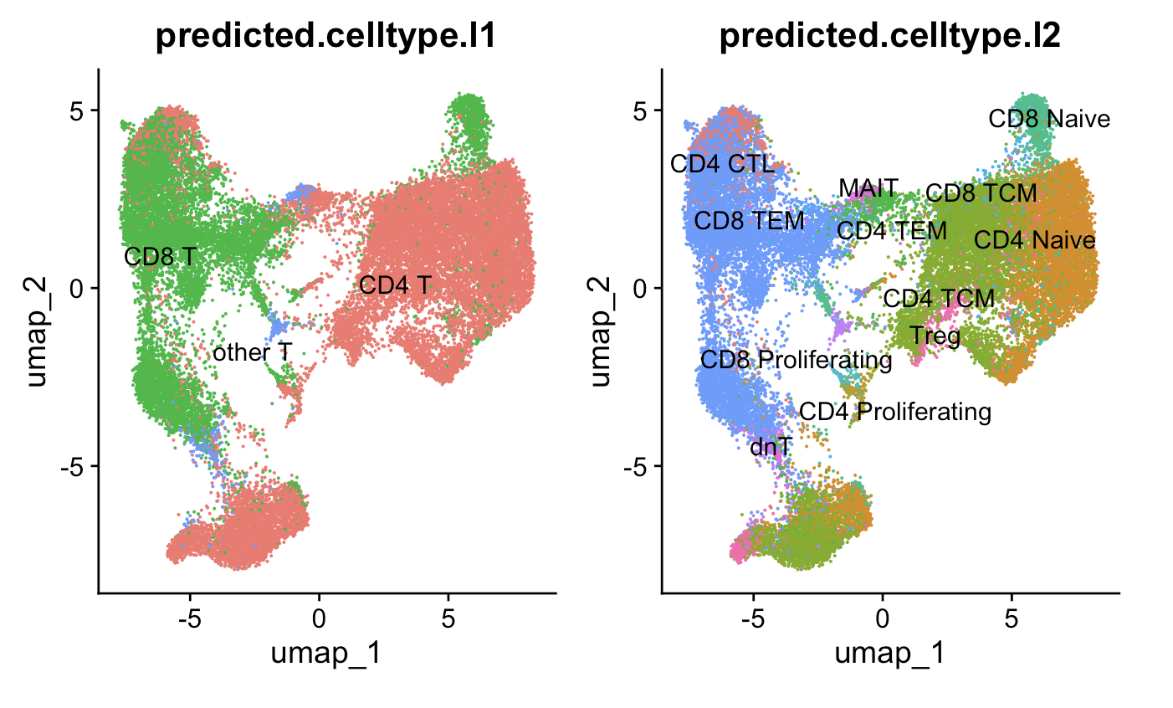
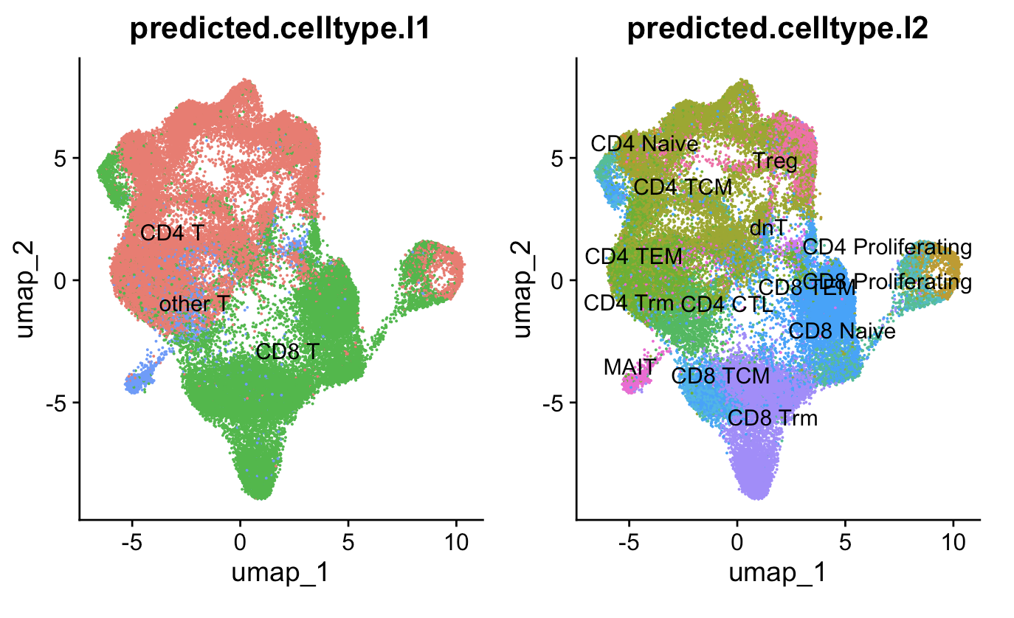
Clustering, reference mapping
PBMC myocarditis-focused dataset (~30k T cells)
Colon tissue colitis dataset (~50k T cells)
Clusters with high CD69 are CD4 Trm,
high CD49a/CD101/CD103 are CD8 Trm
Notes:
Why I used different cell typing methods
didn’t want to use manual markers (as both papers at least partially did), even though I ended up doing this to get Trms
Mostly agree anyways so it’s not that big of a deal
Worth following up with new cell typing methods perhaps as a next step
4) Cell type abundance differences robust i.e. seen via both methods more interesting to follow up on (i.e. proliferating CD4 Ts)
Ref mapping:
We then find anchors between reference and query.
We then transfer cell type labels and protein data from the reference to the query. Additionally, we project the query data onto the UMAP structure of the reference.

Slide 25
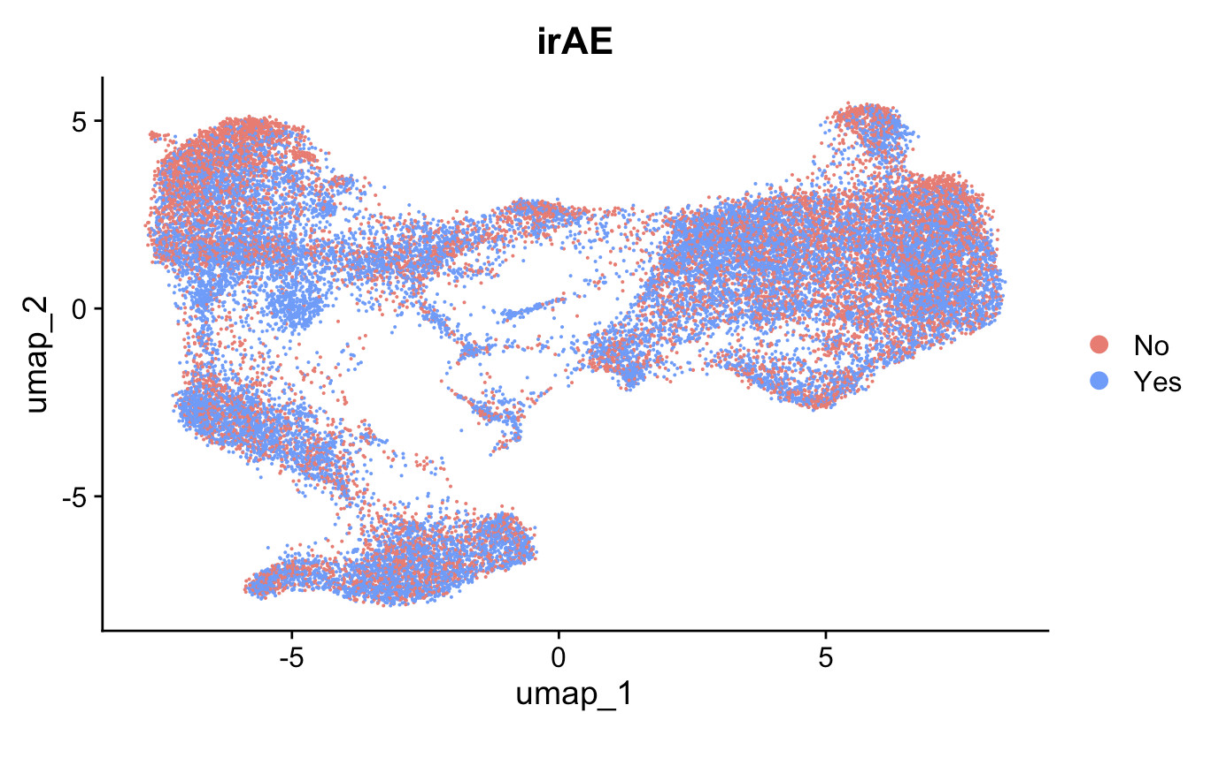
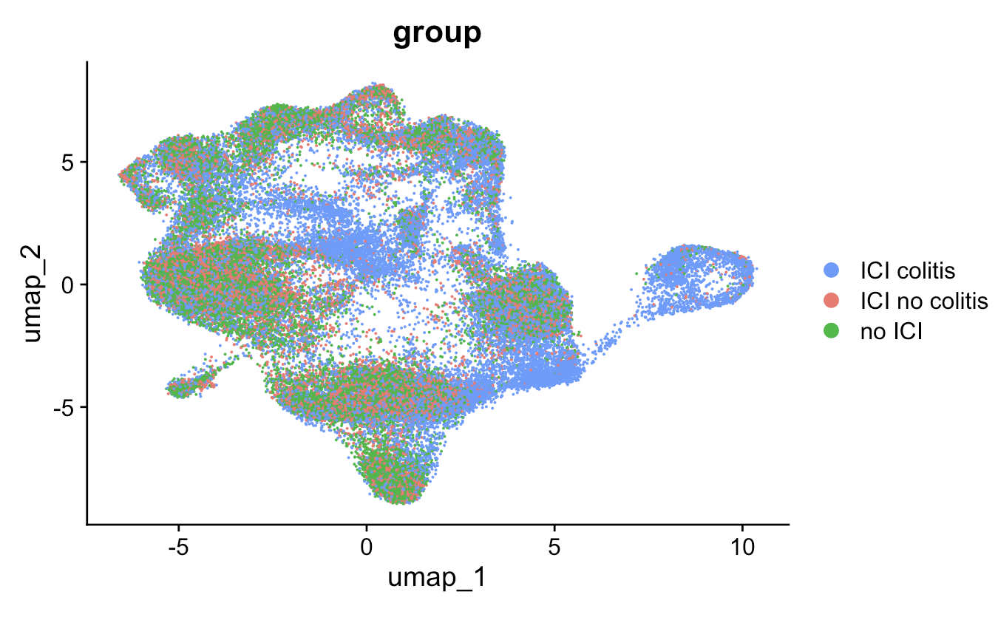
Reassuringly, some cell types seem differentially abundant in colon tissue colitis dataset
PBMC myocarditis-focused dataset
Colon tissue colitis dataset

Slide 26
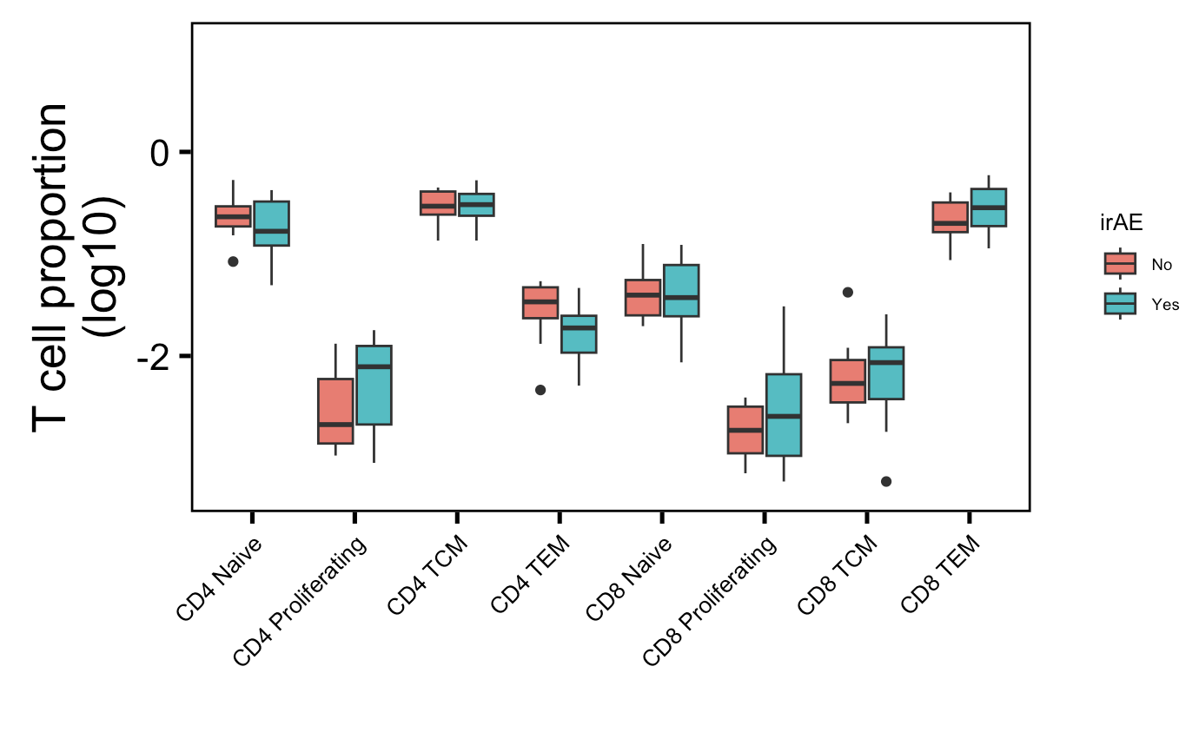
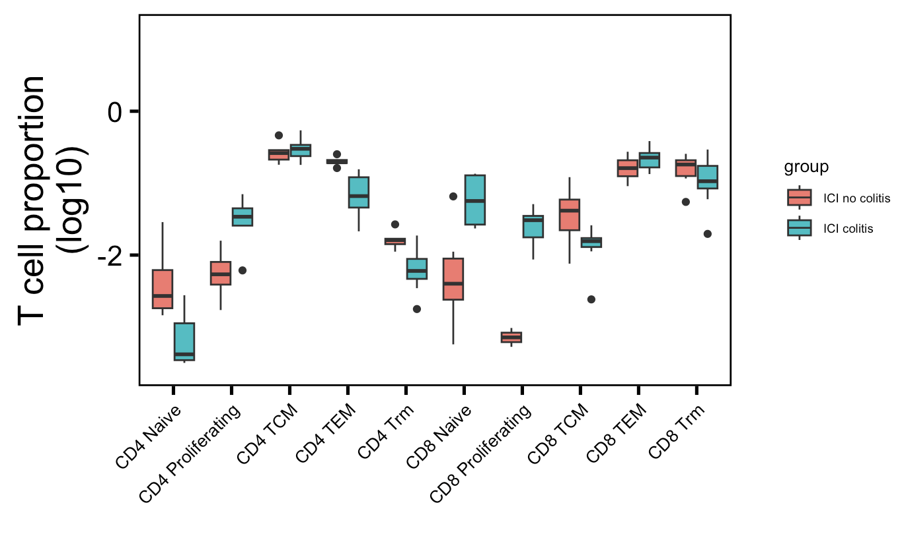
Recapitulate more proliferating CD4 T cells in irAE colitis tissue
→
: up in their analysis
→
: down in their analysis
PBMC myocarditis-focused dataset (mostly PD-1 blockade)
Colon tissue colitis dataset (CTLA-4/combo blockade)
→
→
→
→
**
Wilcoxon rank sum test. **, padj < 1e-2
Notes:
Basically not sure how useful this will be for cytometry people as it’s 1) in colon tissue, 2) doesn’t replicate super well with other papers (yes it does with same paper though but…)

Slide 27
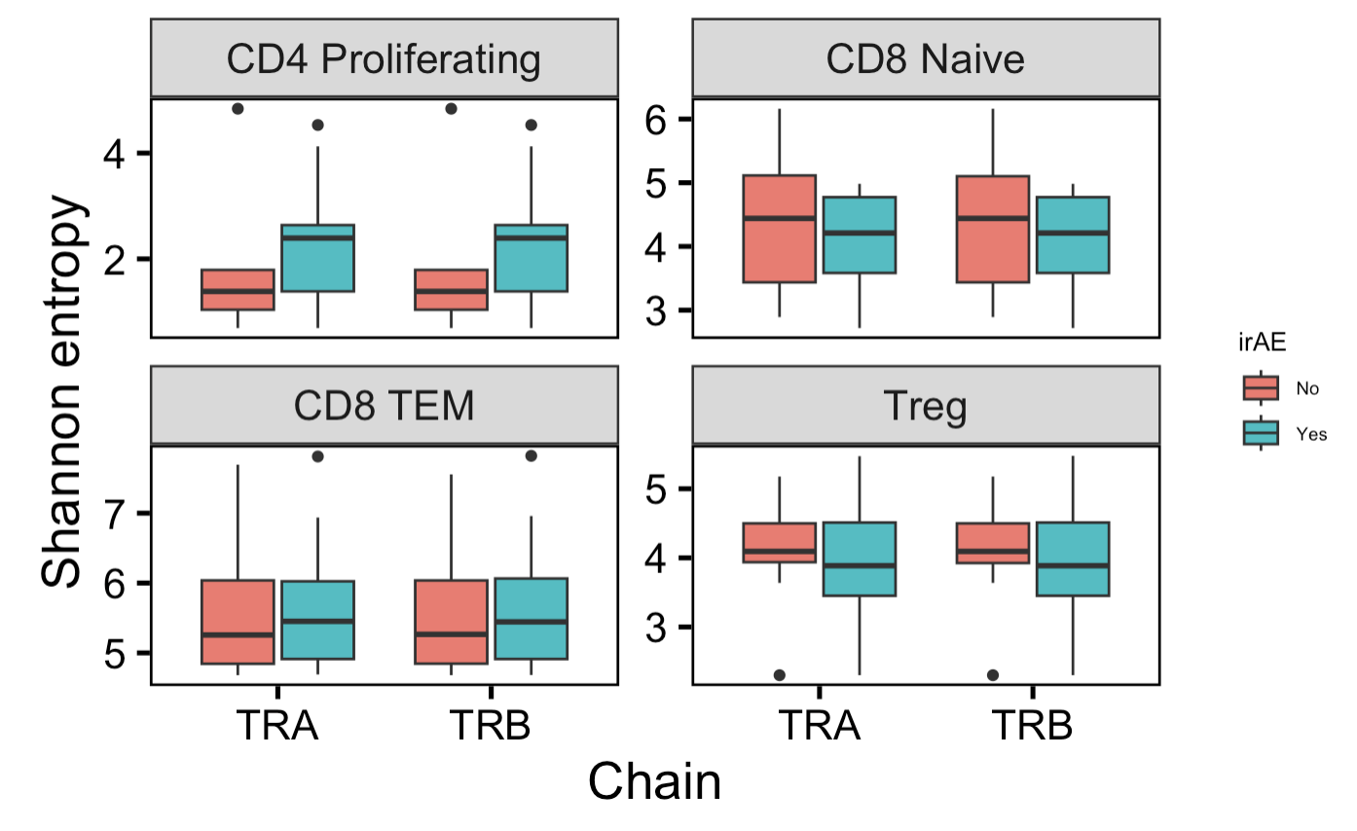
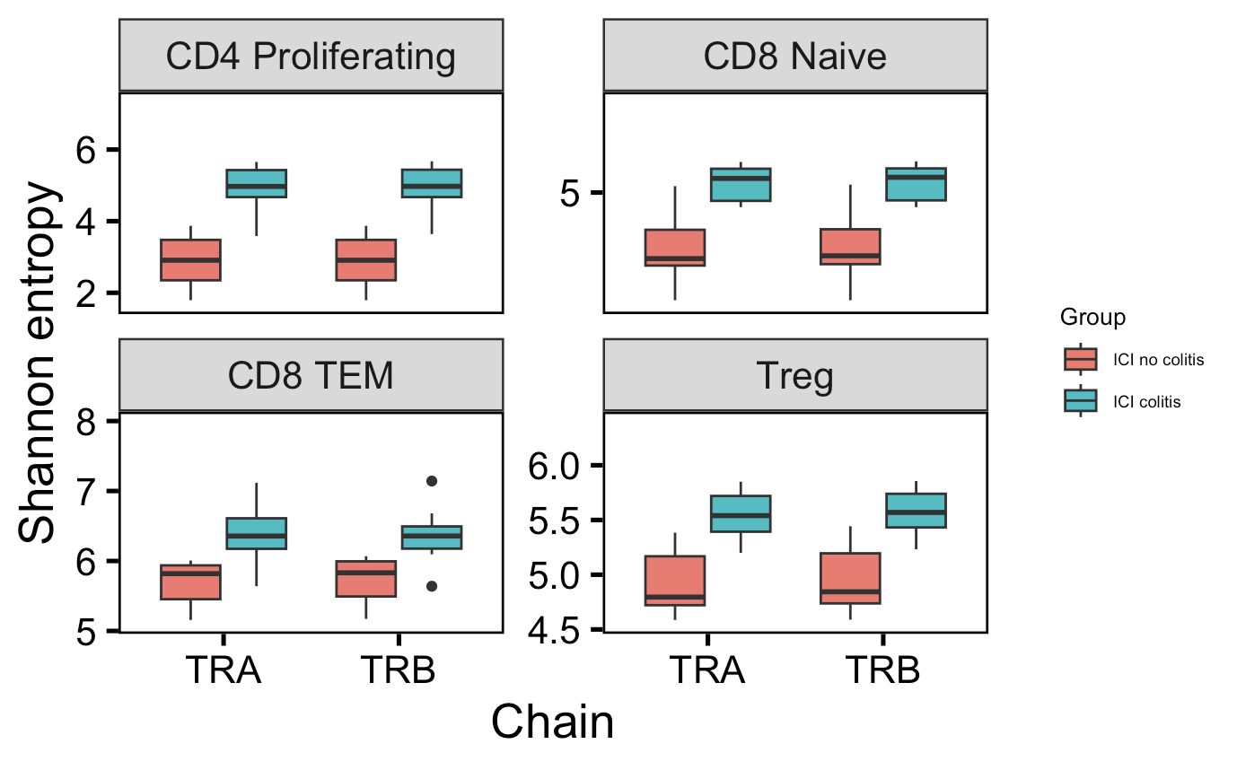
Some cell types have more diverse repertoires in colitis tissue
PBMC myocarditis-focused dataset (mostly PD-1 blockade)
Colon tissue colitis dataset (CTLA-4/combo blockade)
*
*
*
*
*
*
*
*
Wilcoxon rank sum test. *; padj < 0.05
Notes:
This is expected given literature introduction (T cell expansion/diversity associated with irAE)
# Shannon entropy: 0 means monoclonal, higher means polyclonal, weights richness (total # of unique clones) over evenness
PD-1 blockade induces more clonal repertoires (PMID: 25428505), vs. CTLA-4 blockade inducing more diverse ones it seems…

Slide 28
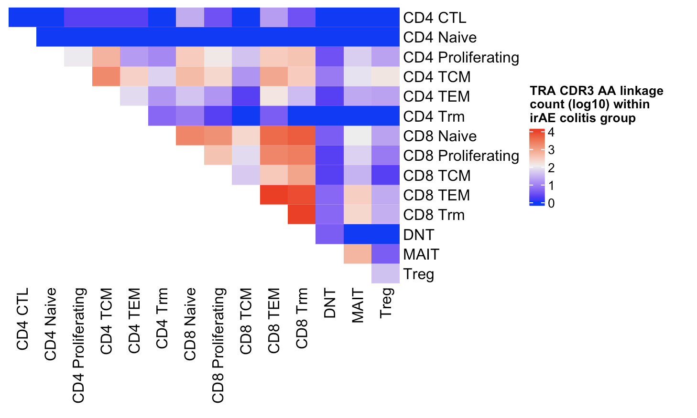
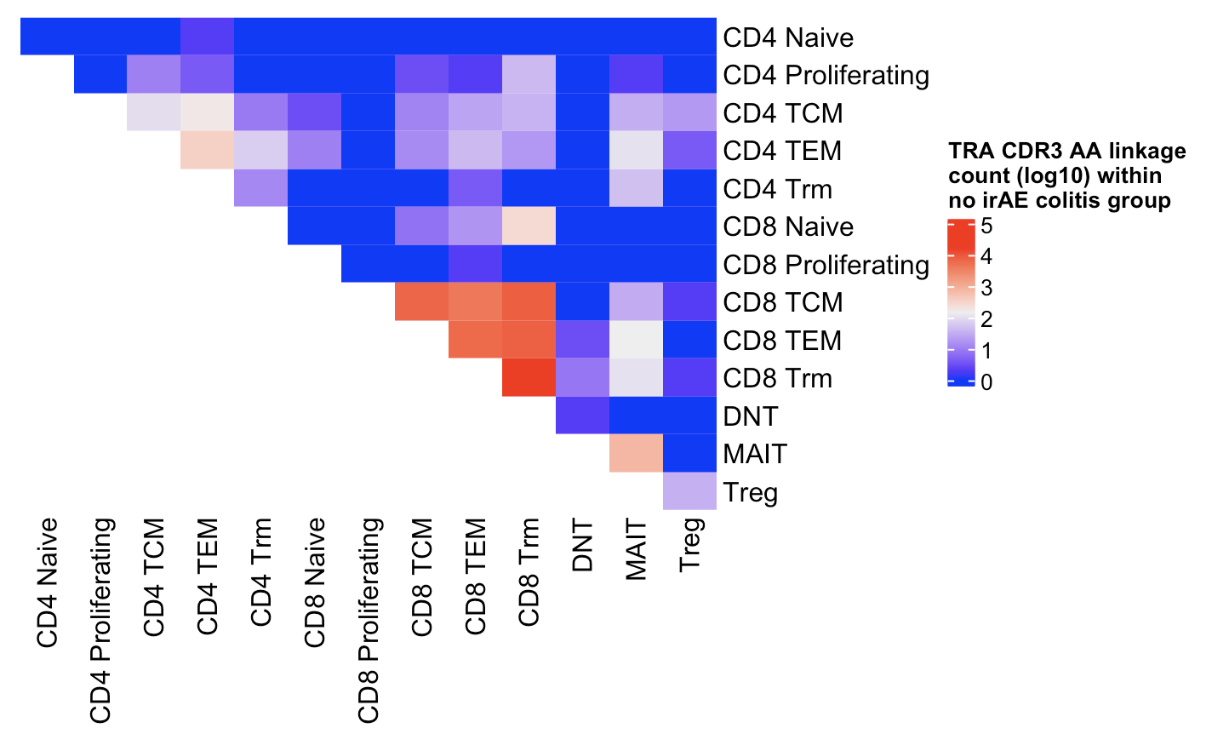
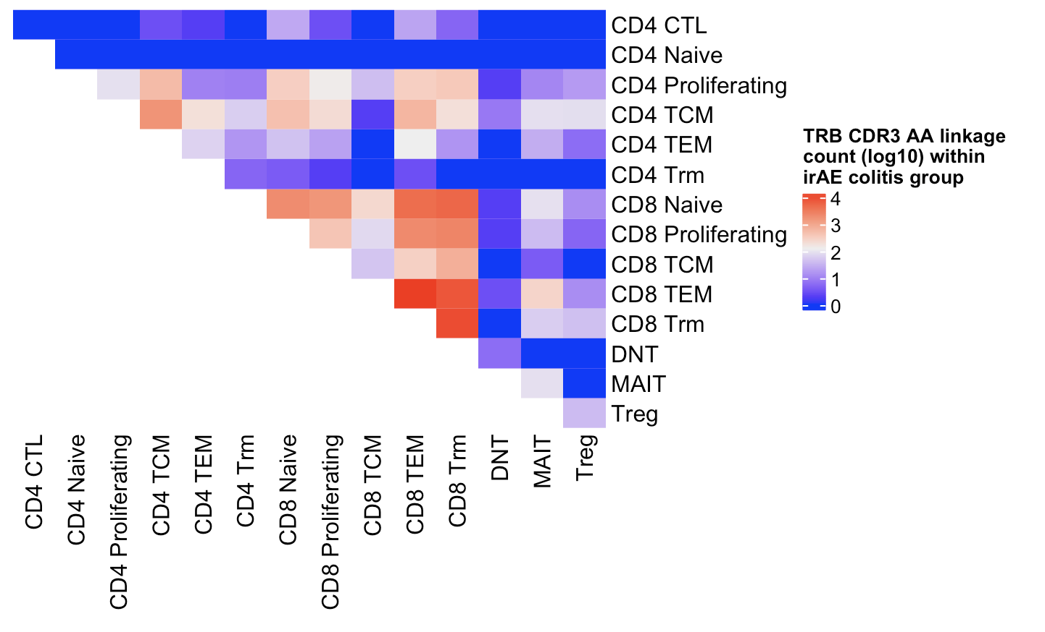
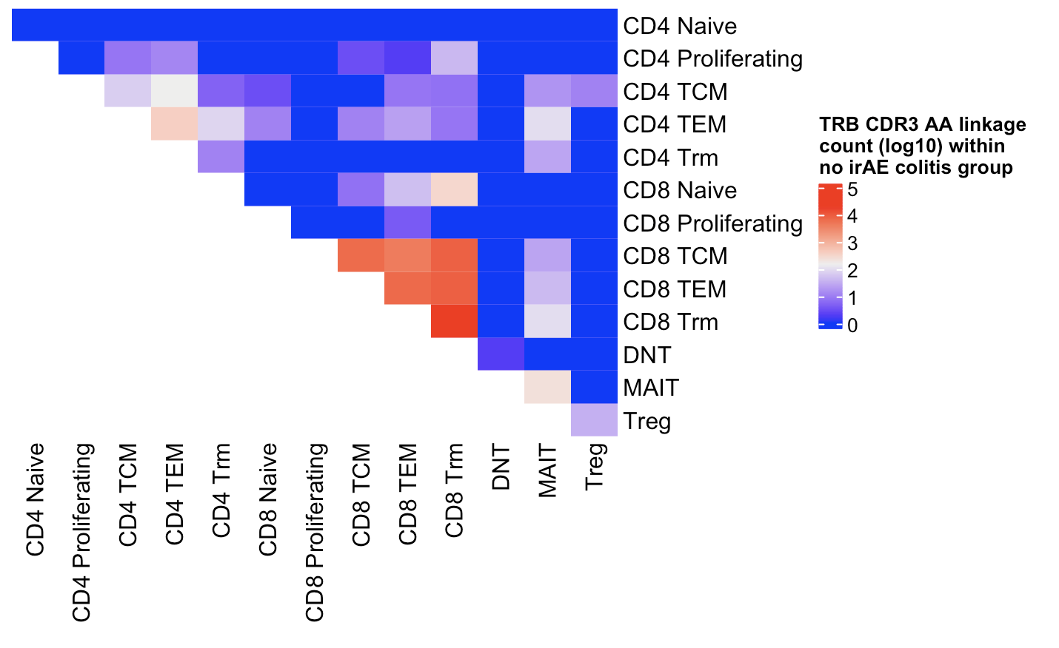
Colon tissue colitis dataset: recapitulate CDR3 AA linkage spreading across more cell types within irAE group, high sharing between CD8 Trms and CD8 TCM/TEM
Notes:
Mine includes singletons, theirs didn’t

Slide 29
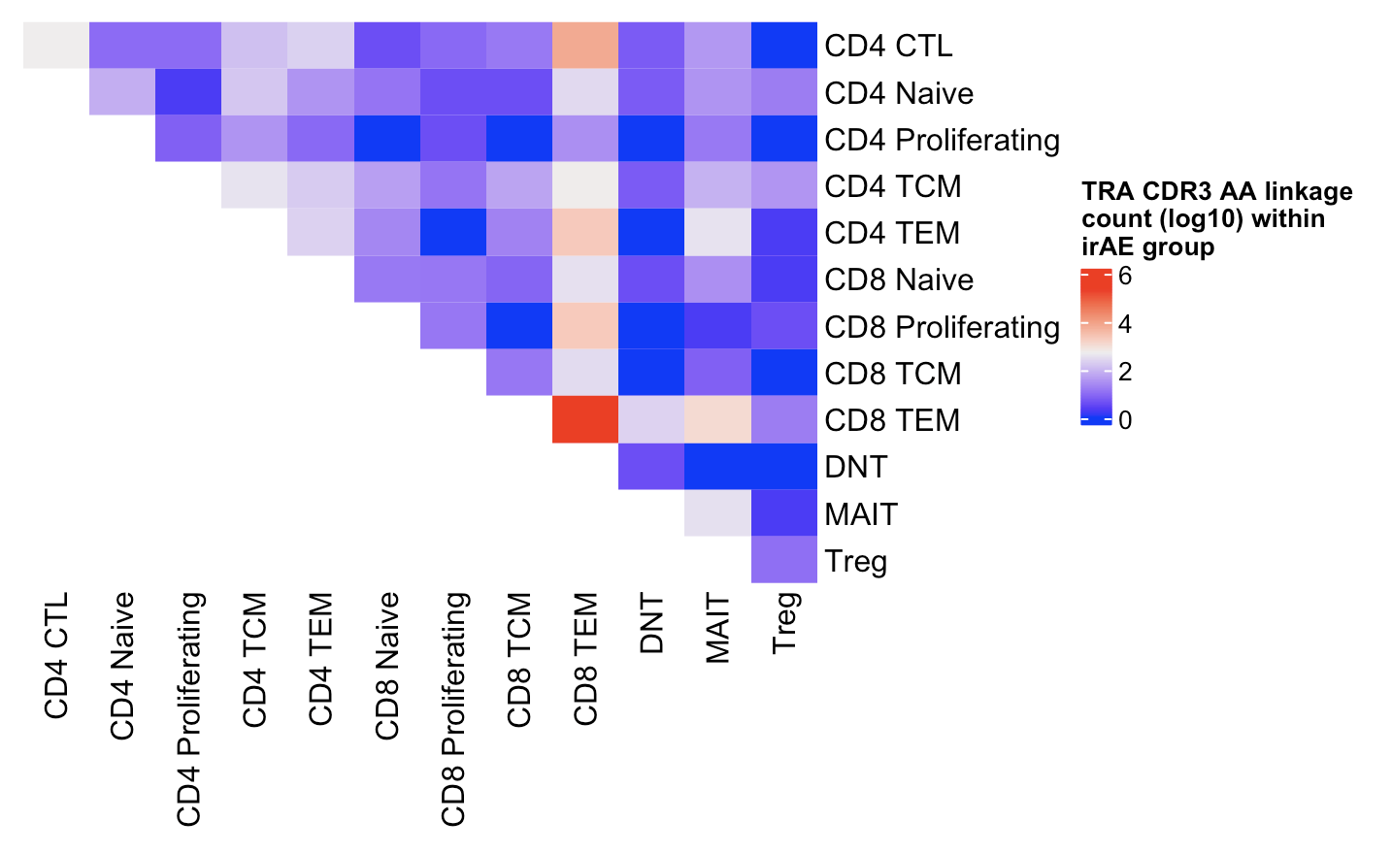
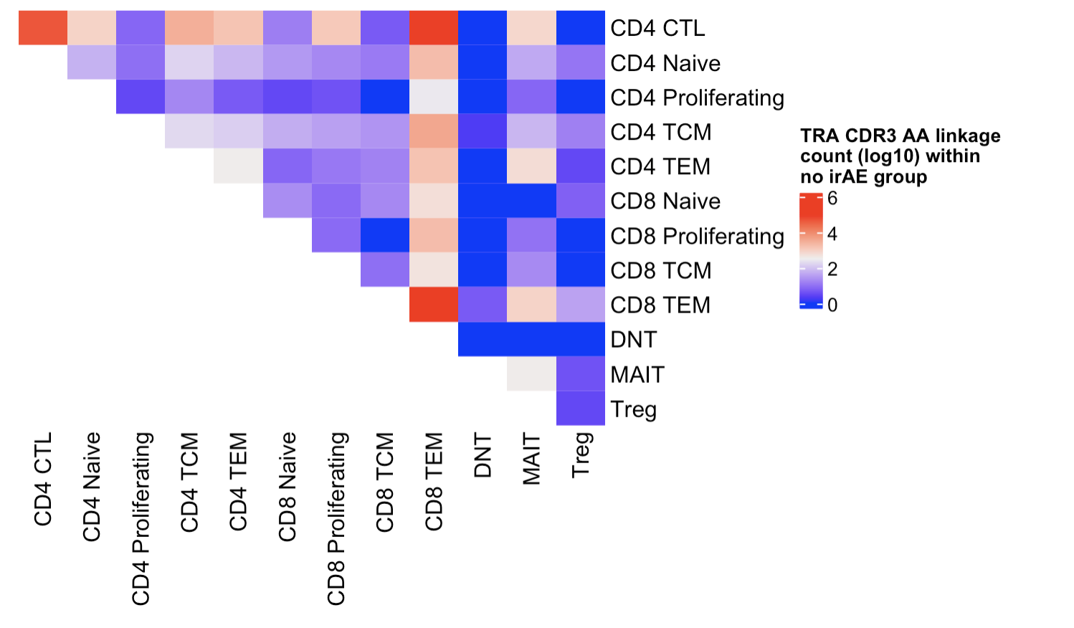
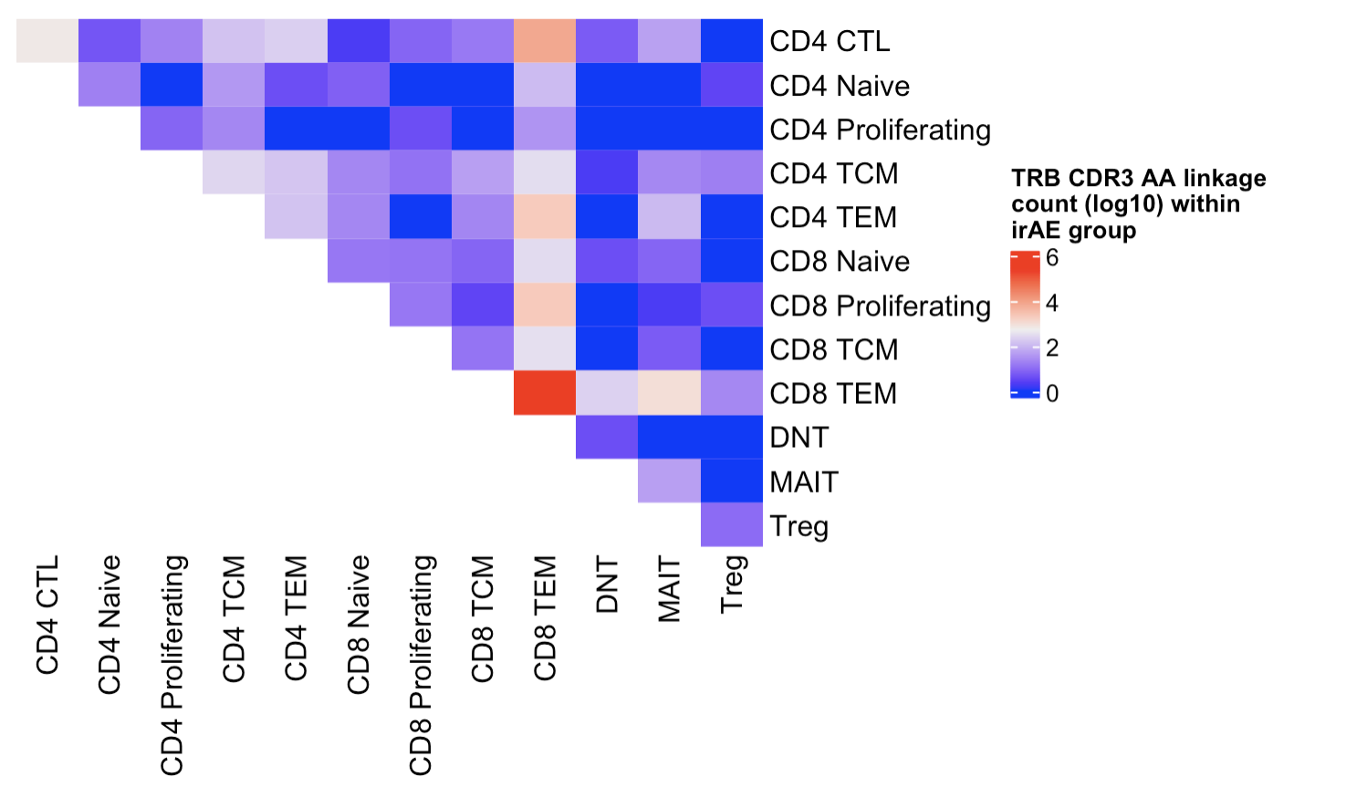
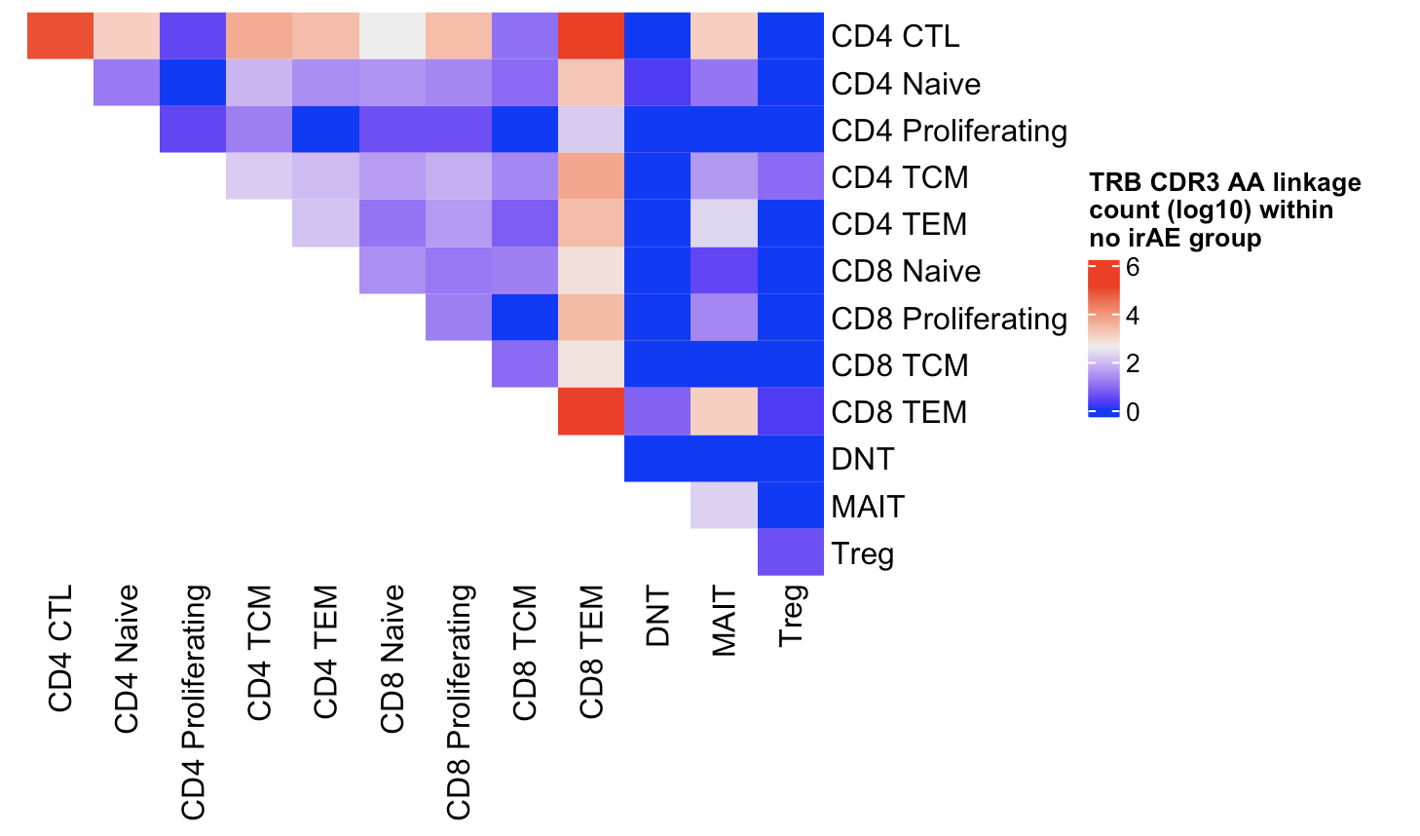
PBMC myocarditis-focused dataset CDR3 AA linkages may be spread across more cell types within no irAE group

Slide 30
Feature analysis methods
Use Stitchr package (Heather et al. Nucleic Acids Res. 2022) to produce TCR sequences from VJ and CDR3 sequences
CDR3 length/hydrophobicity and TCR probability of generation (pgen via IGoR, Marcou et al. Nat Commun. 2018) analyses for unique TCRs
Notes:
Stitchr: basically looks for sequence matches between N terminus and C terminus of junction and V gene, incrementally deleting V gene residues until it finds junction. Then use non-V portion of CDR3 to search J gene, then remainder for search D gene (TRB). Then get seq by trim reference and use most common codon for species
IGoR: IGoR starts by listing the possible recombination and hypermutation scenarios leading to an observed sequence in the data set, then assigns probability weights reflecting the likelihood of these scenarios, IGoR restricts its exploration to the reasonably likely ones to save on computational cost
computational pipeline: V(D)J recombination proceeds by joining randomly selected segments (V, D, and J segments in the case of TRB and IGH), each segment gets trimmed at its ends (hashed areas), and a varying number of non-templated insertions are added between them, IGoR lists putative recombination scenarios consistent with the observed sequence, and weighs them according to their likelihood, the likelihood of each scenario is computed using a Bayesian network of dependencies between the recombination features (V, D, J segment choices, insertions, and deletions)

Slide 31
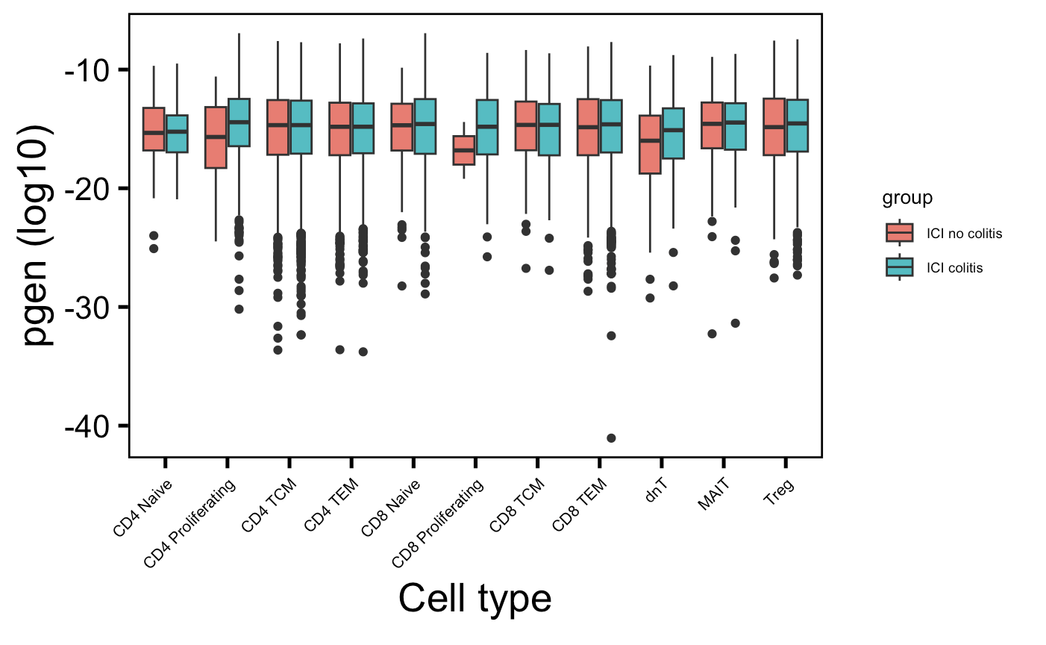
Proliferating CD4 T cell TRB chains from colon tissue colitis dataset are slightly more germline-like in irAE colitis group
*
→
More germline-like
Less germline-like
→
Wilcoxon rank sum test. *, padj < 0.05
Notes:
If downsampled, unadjusted p val for CD4 prolif germline effect is ~0.02 (same effect direction), not downsampled it was like 0.004…

Slide 32
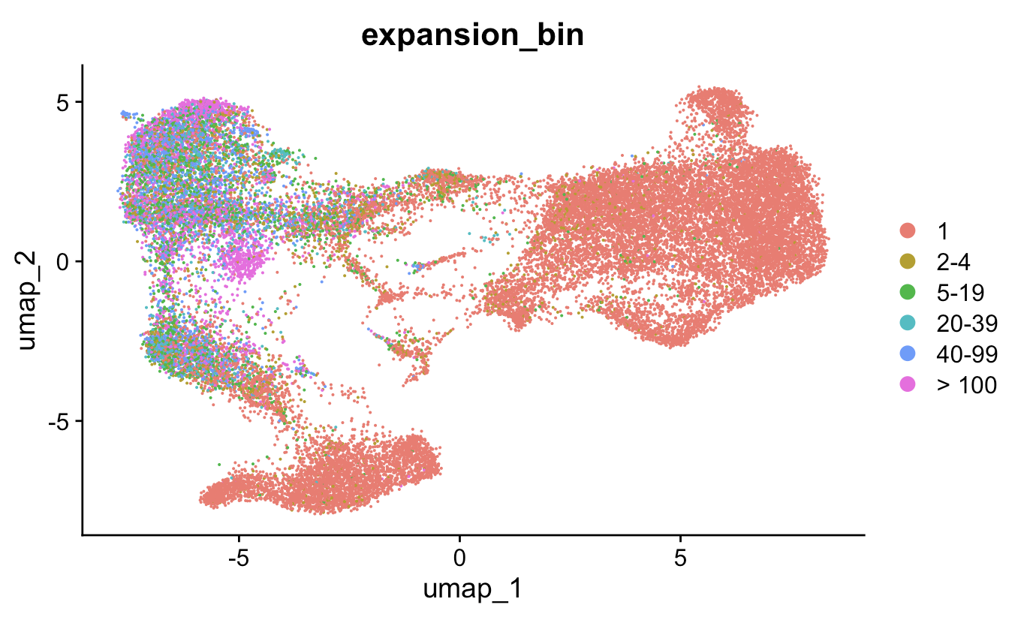
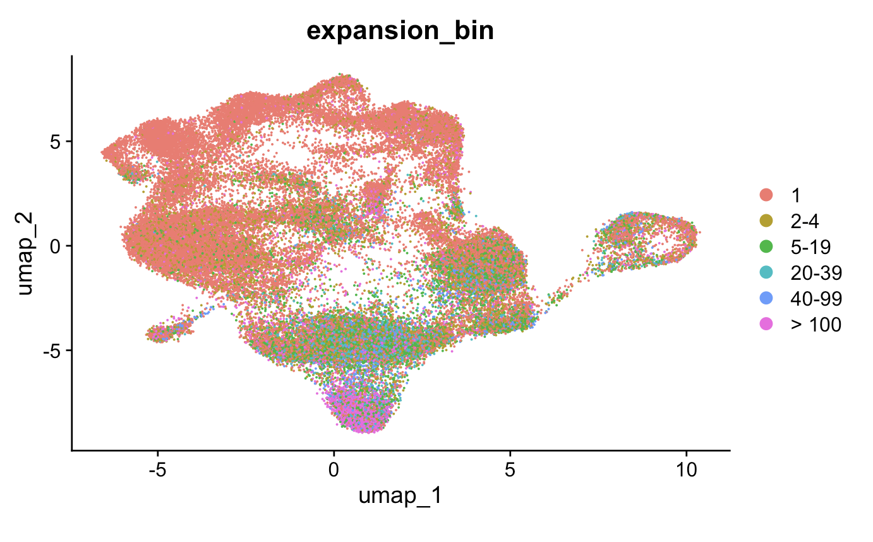
Antigen exposure induces T cell expansion
PBMC myocarditis-focused dataset
Colon tissue colitis dataset
Notes:
CD8s seem more highly expanded in both datasets it seems

Slide 33
Feature analysis within T cell expansion bins for each cell type
Normalize clonotype counts within each patient by sum of clonotypes for that patient (clonotype depth)
Slice to only look at unique clonotypes from each patient
Arrange by normalized clonotype counts within cell type, chain groups
Create 20 bins per cell type, chain group, i.e. bin 1 is top 5% expanded clonotypes for that chain-cell type across patients, bin 2 is top 10%...
Perform Wilcox rank sum test up to each bin for each cell type, chain group for features of interest
Create heatmaps of –log10(padj value) by cell type, chain, feature groups across % repertoire bins

Slide 34
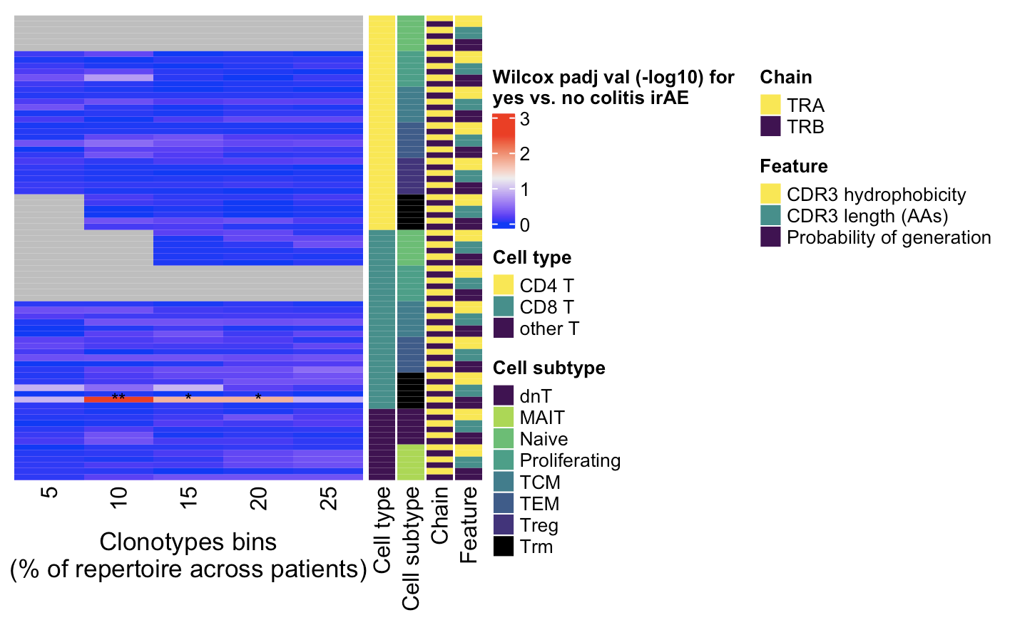
Some colon tissue colitis dataset features between irAE groups may be different
← Higher expansion
Wilcoxon rank sum test. **, padj < 1e-2; *; padj < 0.05
Notes:
Cumulative binning!
only a small portion of an antigen is needed to be recognized by a TCR (8-10 amino acids for MHCI, 14-18 for MHCII, does this mean that CD8<sup>+</sup> T cells might be more cross-reactive?)
T cell repertoire analysis and metrics of diversity and clonality
CDR1-2 contact MHC and CDR3 contacts peptide is the general rule, but CDR1α also contacts peptide and CDR3β doesn't contact peptide too much
The length of the CDR3 loop greatly influences its shape and ability to fold both on itself and in the company of others loops such as the CDR1 and CDR2 (Davis et al., 1998, Wu et al., 2002): https://www.sciencedirect.com/science/article/pii/S0161589006002148?via%3Dihub

Slide 35
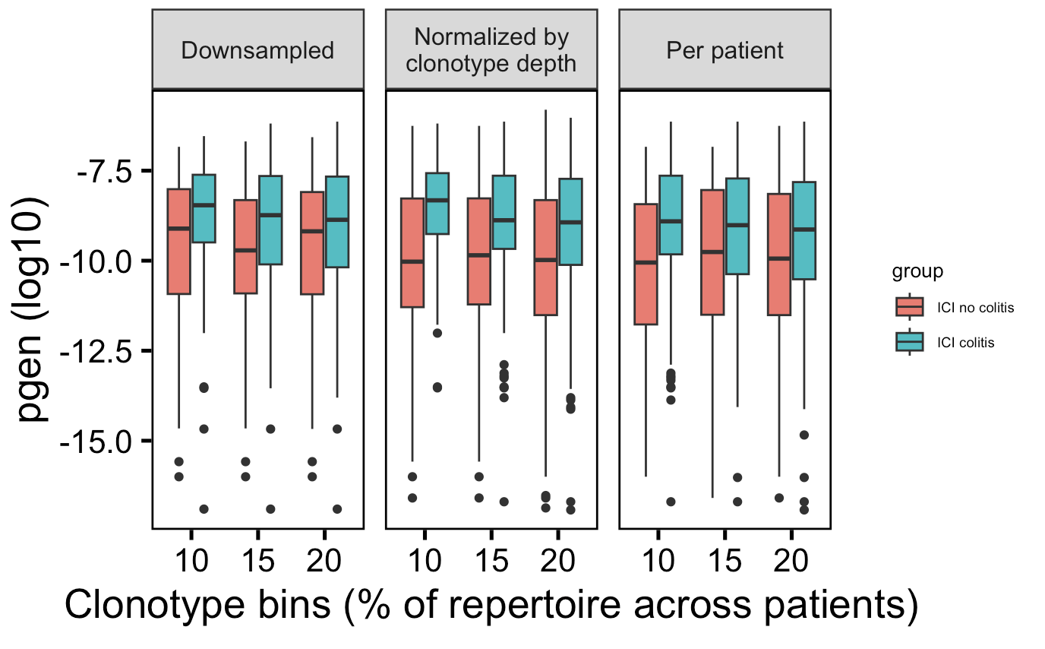
Highly expanded CD8 Trms may have more germline-like TRAs in those developing colitis, likely driven by patient bias though
**
*
*
→
More germline-like
Less germline-like
→
Wilcoxon rank sum test. **, padj < 1e-2; *; padj < 0.05
Notes:
Clonotypes/bin: 50 (downsampled), 80 (normalized), 87 (per patient), not exactly sure why more in per patient than normalized so removing from slide…
Context of BRI/VDJdb data…
Public/shorter CD4 TRAs/higher pgen expected more crossreactive from BRI/VDJdb data... (VDJdb not pgen, BRI all 3)
Cumulative binning
only a small portion of an antigen is needed to be recognized by a TCR (8-10 amino acids for MHCI, 14-18 for MHCII, does this mean that CD8<sup>+</sup> T cells might be more cross-reactive?)
T cell repertoire analysis and metrics of diversity and clonality
CDR1-2 contact MHC and CDR3 contacts peptide is the general rule, but CDR1α also contacts peptide and CDR3β doesn't contact peptide too much
The length of the CDR3 loop greatly influences its shape and ability to fold both on itself and in the company of others loops such as the CDR1 and CDR2 (Davis et al., 1998, Wu et al., 2002): https://www.sciencedirect.com/science/article/pii/S0161589006002148?via%3Dihub

Slide 36
Negative results summary (data not shown)
No differences in convergence, publicity, privicity frequencies between irAE groups by chain, cell type
No differences in VJ gene usage between irAE groups
No DEGs between…
proliferating CD4 T cells in colitis vs. no colitis tissue
highest and lowest CD8 Trm TRA pgen cells in colon tissue colitis dataset

Slide 37
Indeterminate results summary, perhaps hinting at connection between TCR germline-ness and crossreactivity
Proliferating CD4 T cell TRB chains are slightly more germline-like in irAE colitis group
Highly expanded CD8 Trms may have more germline-like TRAs in those developing colitis, likely driven by patient bias though
Notes:
perhaps hinting at a connection between germline-ness and crossreactivity, i.e more germline-like TCRs might be more cross-reactive as they have lower sequence complexity
Context of BRI/VDJdb data…
Public/shorter CD4 TRAs/higher pgen expected more crossreactive from BRI/VDJdb data... (VDJdb not pgen, BRI all 3)

Slide 38
Positive results summary
Recapitulated colon tissue colitis dataset’s results
More proliferating CD4 T cells in irAE colitis tissue
CDR3 AA linkages across more cell types within irAE colitis group, high sharing between CD8 Trms and CD8 TCM/TEM
CD4 proliferating T cells, CD8 naïve T cells, CD8 TEMs, and Tregs have more diverse repertoires in colitis tissue
Some public/private TCR subgroups show distinct TCR features between irAE groups (data not shown)
Colon tissue colitis dataset: private CD8 TEM TRB pgen and CDR3 length
PBMC myocarditis-focused dataset
Public CD8 Naïve TRB pgen
Private CD4 TEM TRA pgen
Private Treg TRA CDR3 length
We can mine public data and use it in tandem with BRI data, for example using one as a training set and the other as a test set
Increased confidence in conclusions that are recapitulated across multiple datasets
Increased breadth of possible research questions to investigate
Notes:
Identification of neoantigens for individualized cancer immunotherapy
cross-reactivity is possible due to low affinity of functional TCR-pMHC interaction
Lack of necessity for super high affinity TCR-pMHC may support more alternative contacts ~= more crossreactive hypothesis (i.e. longer CDR3 may disrupt peak affinity but may allow more possible ok TCR-pMHC interactions sufficient to induce T cell activation)
Context of BRI/VDJdb data…
Public/shorter CD4 TRAs/higher pgen expected more crossreactive from BRI/VDJdb data... (VDJdb not pgen, BRI all 3)

Slide 39
Next steps
Linkage analysis
Investigate many junctions shared across datasets
Compare TCR features between linkage groups
Trajectory analysis
Look for genes whose expression correlates with TRA pgen in CD8 Trms
Compare SingleR to Seurat refence mapping cell typing results
Extending analysis to more datasets
Flow cytometry, CyTOF, CITE-seq (instead of RNAseq for cell typing) + TCRseq

Slide 40

Acknowledgements
Peter Linsley
Datasets
Colon tissue colitis: Luoma et al. Cell. 2020
PBMC myocarditis-focused: Zhu et al. Circulation. 2022
Bioinformatics group
Alex Hu
Erin Witkop
Matt Dufort
Matt Lawrence
Hannah DeBerg
Thomas Edwards
Tomasz Janczyk

Slide 41
Extra slides

Slide 42
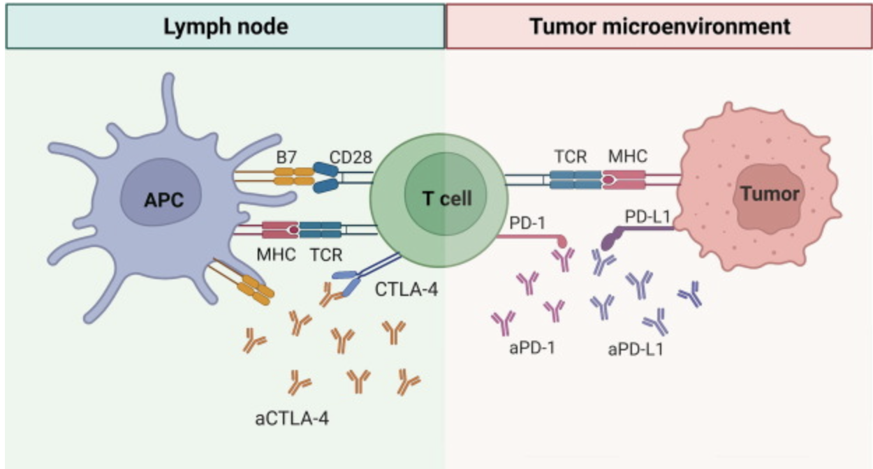
PD-1 and CTLA-4 blockade induce distinct responses despite both converging on Akt signaling
PD-1 blockade more CD8 (immune “normalizer”), CTLA-4 more CD4 (immune “enhancer”)
PD-1 blockade associated with fewer irAEs
PD-1 blockade induces more clonal TCR repertoire, CTLA-4 blockade induces more diversified TCR repertoire
Notes:
Picture: Advanced materials for management of immune-related adverse events induced by immune checkpoint inhibitors
Distinct cellular mechanisms underlie anti-CTLA-4 and anti-PD-1 checkpoint blockade
- PD-1 blockade predominantly induces expansion of specific tumor infiltrating exhausted-like CD8<sup>+</sup> T cell subsets
- CTLA-4 blockade induces expansion of ICOS<sup>+</sup> Th1-like CD4<sup>+</sup> effector T cells, also engages specific subsets of exhausted-like CD8<sup>+</sup> T cells
Immune-related adverse events in checkpoint blockade: observations from human tissue and therapeutic considerations
PD-1 blockade more CD8 effect, CD4 effect more for CTLA-4 blockade
Mechanisms of immune-related adverse events during the treatment of cancer with immune checkpoint inhibitors
anti-CTLA-4 and anti-PD-1/PD-L1 antibodies called "immune enhancers" and "immune normalizers" (normalizing T cell immunity in tumor microenvironment), respectively, consistent with PD-1 blockade having less irAEs
CTLA-4 and PD-1 signaling converge on Akt, regulator of T cell activation
CTLA-4 blockade induces more diversified T cells (including autoreactive ones), PD-1 blockade induce more clonal TCR repertoire and proliferation of intratumoral CD8<sup>+</sup> T cells

Slide 43


Some patient bias in CD4 T proliferating TRB pgen effect (lower in no colitis group)
All unique TCRs
Downsampled TCRs

Slide 44

Baseline abundances of different cell types have been associated with different organ irAEs
Notes:
lower baseline levels of CD8 TCM cells in arthritis irAE patients, higher CD4 Th2 baseline levels in pneumonitis irAE patients, higher CD4 Th17 baseline levels in thyroiditis irAE patients (PMID: 36513074)

Slide 45

Highest and lowest CD8 Trm TRA pgen cells do not have distinct transcriptional phenotypes
Notes:
No padj < 0.05 (or anywhere close) after pseudobulk analysis
Top and bot here are for pgen (log10), so top here is most germline-like and bot is least germline-like
- perhaps ICB reinvigorates T<sub>RM</sub> cells and patients with more crossreactive Trms get irAEs

Slide 46
Converged TCRs mark antigen exposed T cells and are associated with ICB response (PMID36350695)
Public CDR3 AAs
CDR3 AA present in > 1 patient
Perhaps from germline recombination biases/convergent recombination or TCR convergence
TCR convergence
> 1 CDR3 nt leading to CDR3 AA
Perhaps from selection due to persistent antigen exposure
Notes:
# Sharing of T cell receptors in antigen-specific responses is driven by convergent recombination
- convergent recombination, rather than recombination bias or selection, drives publicity
- potential causes of publicity: self tolerance restricts capacity of TCRs to recognize some epitopes, different conformations of peptides in MHC groove (flat or prominent), degenerate binders
the frequency of random V(D)J recombination events that converge to produce a given nucleotide or amino acid sequence. We term this phenomenon “convergent recombination.”

Slide 47






TRA CDR3AA publicity, privicity, convergence-colored UMAPs
PBMC myocarditis-focused dataset
Colon tissue colitis dataset
Notes:
MAITs most public/converged (TRA), as expected

Slide 48

Within CD4 proliferating T cells from colon tissue colitis dataset, no differences in convergence fraction for either chain or irAE group
Didn’t see differences in convergence (or publicity, privicity) fraction(s) for other cell types in either dataset

Slide 49

Other T cell convergence differences by irAE group in colon tissue colitis dataset observed because of no converged dnT TRB CDR3AAs

Slide 50

Anticorrelation between CDR3 length and germline-ness
→
More germline-like
Less germline-like
→

Slide 51


PBMC myocarditis-focused dataset marker checks
Notes:
# CCR7 high for naive matches ok
# this seems to match ok
# CD8 TCM. CCR7+. CD62L+ (SELL). # CD8 TEM. CCR7-. CD62L-

Slide 52



PBMC myocarditis-focused dataset cell type scores

Slide 53




Colon tissue colitis dataset marker checks

Slide 54



Colon tissue colitis dataset cell type scores

Slide 55
irAEs vs. autoimmune conditions
irAEs progress more rapidly, more transient, often display quicker recovery than autoimmune conditions
Notes:
Immune-related adverse events in various organs caused by checkpoint inhibitors
irAEs progress more rapidly than autoimmune conditions, also transient often with quick recovery
severe irAEs may represent a subclinical or latent autoimmune state that is unmasked upon ICI treatment
Perhaps worth trying to make analogy between viral infections preceeding autoimmunity and tumor response preceeding irAEs?
Immune-related adverse events in various organs caused by checkpoint inhibitors
irAEs progress more rapidly than autoimmune conditions, also transient often with quick recovery
CTLA-4 and PD-1 signaling converge on Akt, regulator of T cell activation
CTLA-4 blockade induces more diversified T cells (including autoreactive ones), PD-1 blockade induce more clonal TCR repertoire and proliferation of intratumoral CD8<sup>+</sup> T cells
severe irAEs may represent a subclinical or latent autoimmune state that is unmasked upon ICI treatment

Slide 56
Effect of tumor type on ICB response
TMB generally a good predictor of ICB response
Good ICB responders
Melanoma
NSCLC
Colon/endometrium cancer (if MMRd and with high microsatellite instablility)
Poor ICB responders
Ovarian cancer
Notes:
ovarian cancers ICB resistant, not known why (perhaps TIM-3 checkpoint), despite tumor-infiltrating leukocytes present in most ovarian cancer patients (or perhaps these are bystanders reactive to viruses rather than tumor antigens)

Slide 57
Predictors of ICB response
Debate over TCR repertoire diversity/clonality predicting ICB response
Notes:
Single cell T cell landscape and T cell receptor repertoire profiling of AML in context of PD-1 blockade therapy
- TCR repertoires expand in responders, contract in therapy resistant patients
some circulating PD-1<sup>+</sup> CD8<sup>+</sup> T cells share TCR sequences with T cells in TME, and this frequency predicts ICB response
in responsive patients peripheral compartment is a major source of T cells activated by ICB and majority of pre-existing intratumoral T cells are terminally exhausted and refractory to ICB
T cell repertoire diversity: friend or foe for protective antitumor response?
high TCR diversity/richness/evenness (all same here, highly polyclonal synonyms) in blood associated with good ICB outcome
# A multi-omic single cell sequencing approach to develop a CD8 T cell specific gene signature for anti-PD1 response in solid tumors
- **neither pre-treatment TCR clonality nor changes in clonality after ICB correlate with response**

